Slide 1


Slide 2
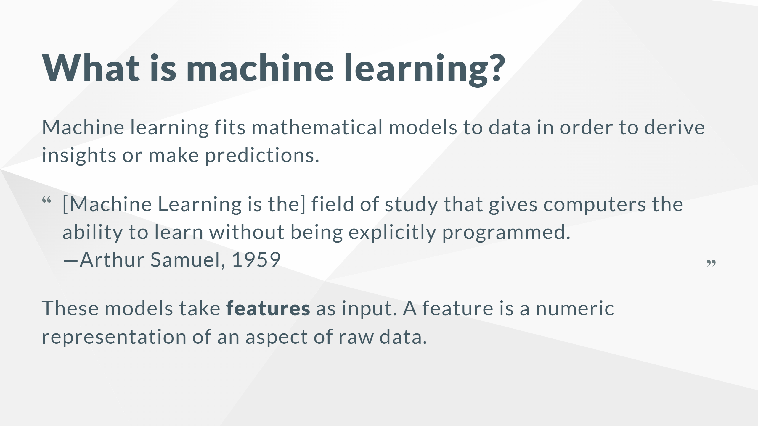
Notes:
Features are used as input variables in models that learn from data to make predictions or decisions without being explicitly programmed.

Slide 3
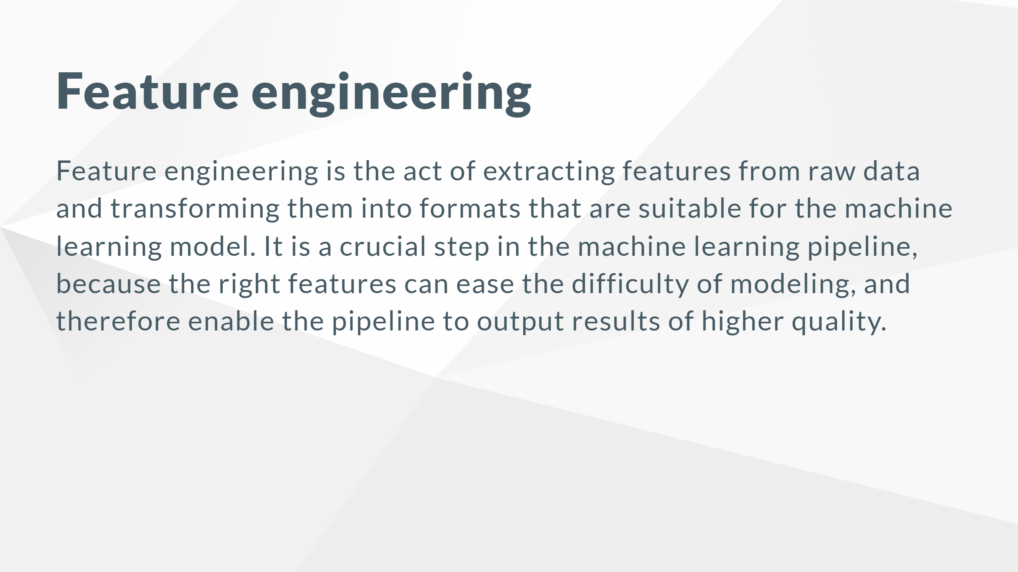

Slide 4
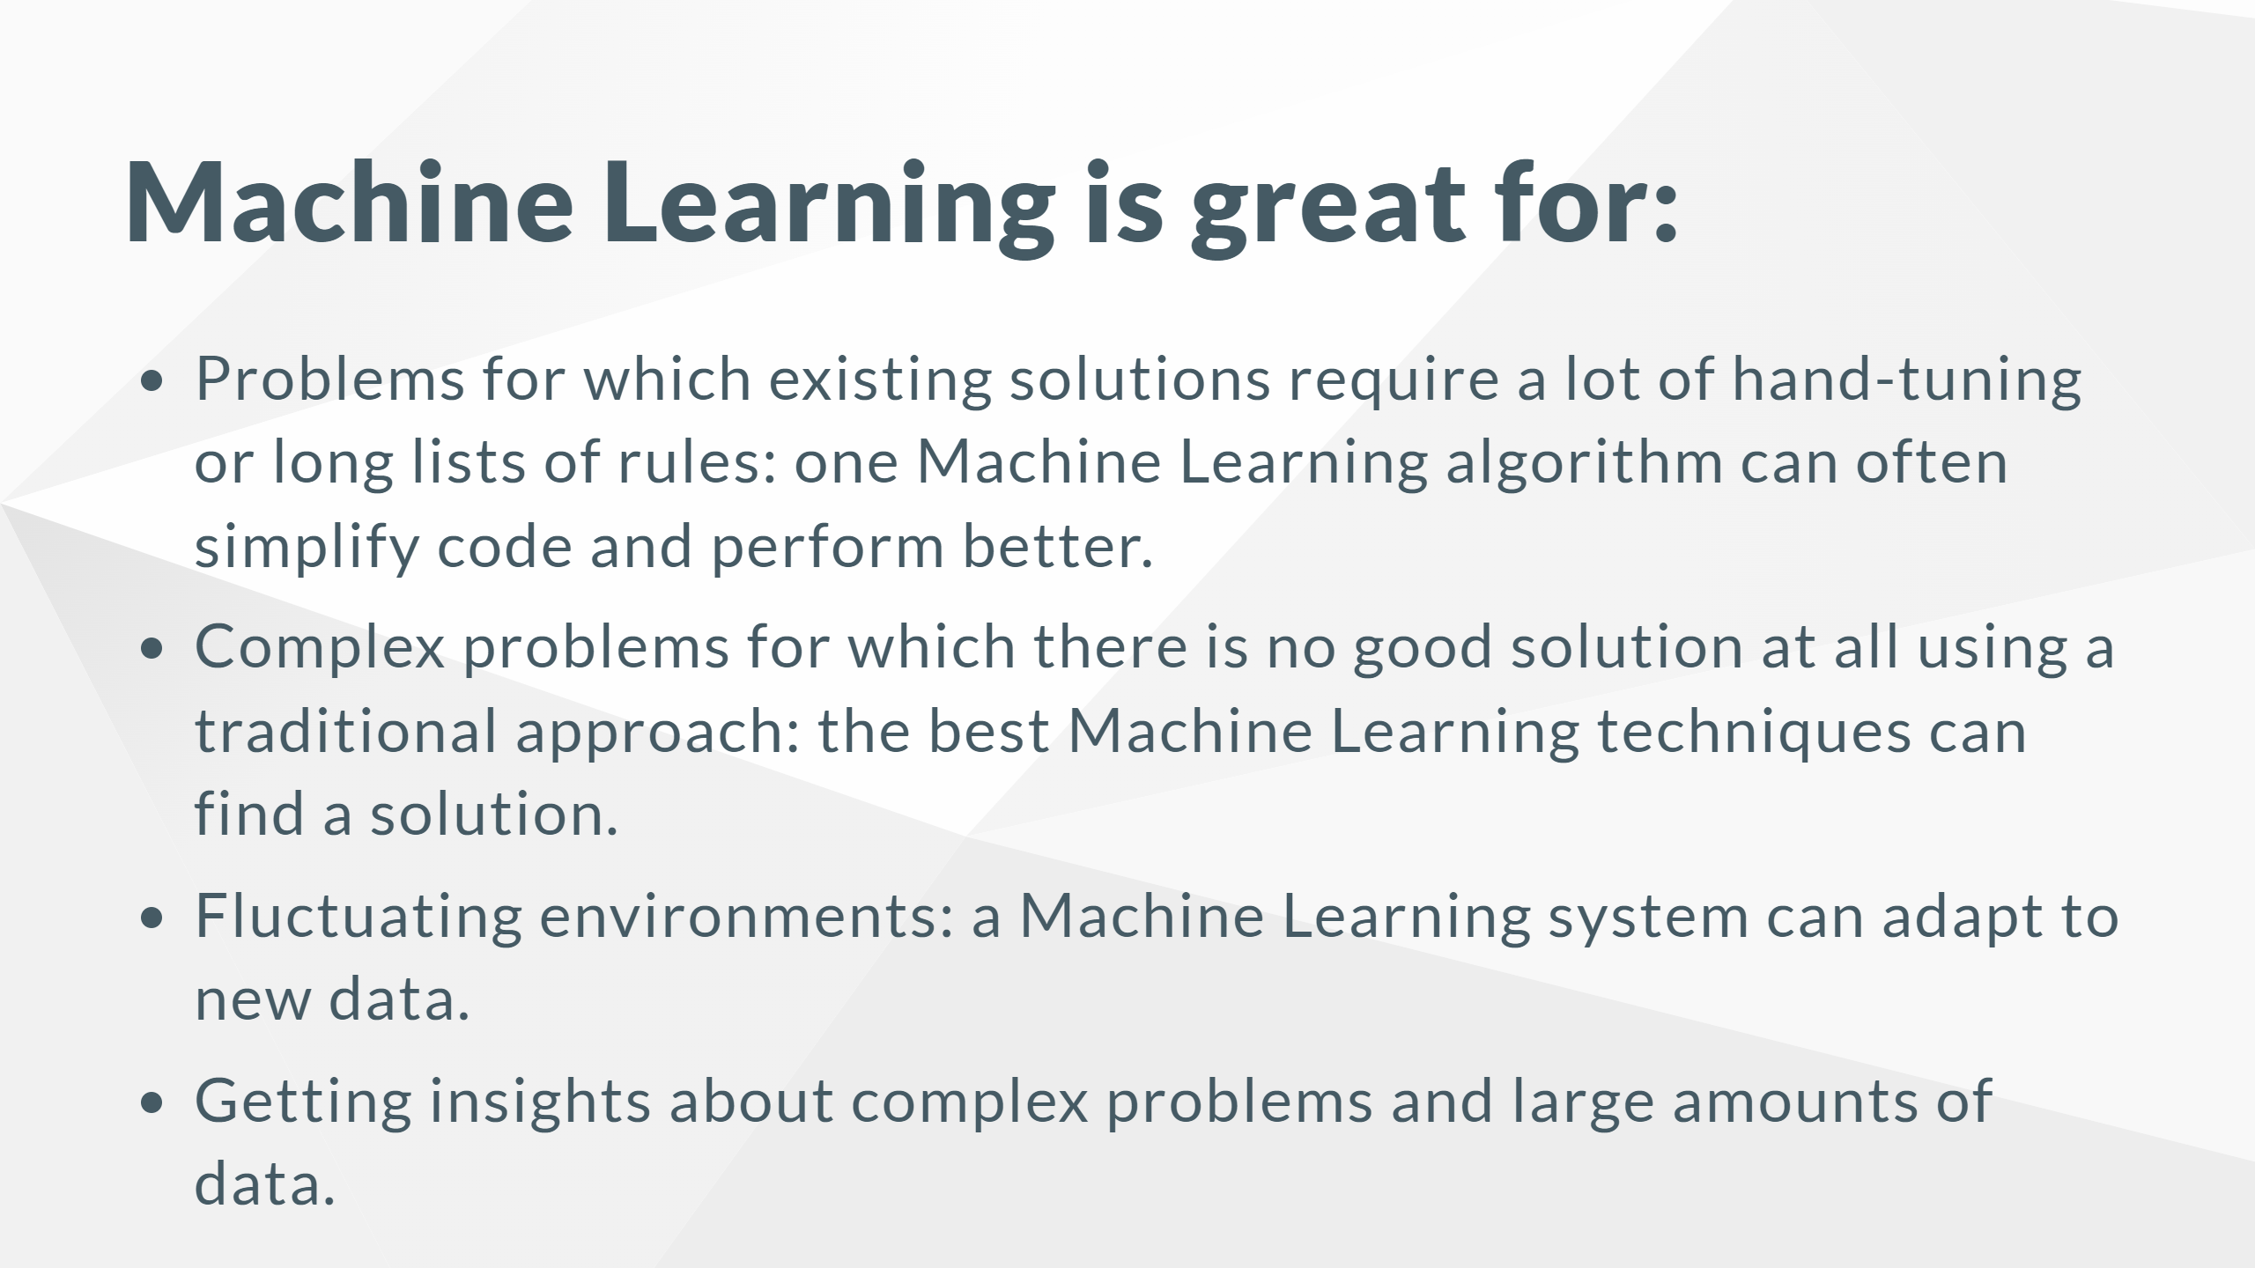

Slide 5
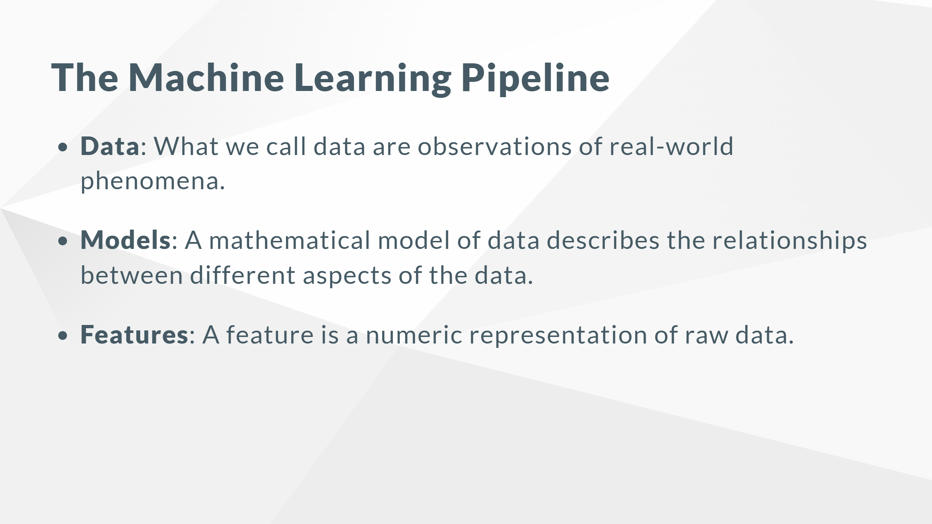
Notes:
Each piece of data provides a small window into a limited aspect of reality. The collection of all of these observations gives us a picture of the whole. But the picture is messy because it is composed of a thousand little pieces, and there’s always measurement noise and missing pieces. For instance, a model that recommends music might measure the similarity between users (based on their listening habits), and recommend the same artists to users who have listened to a lot of the same songs. There are many ways to turn raw data into numeric measurements, which is why features can end up looking like a lot of things. Naturally, features must derive from the type of data that is available.

Slide 6
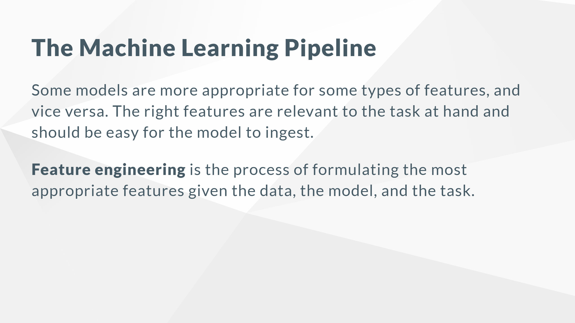

Slide 7
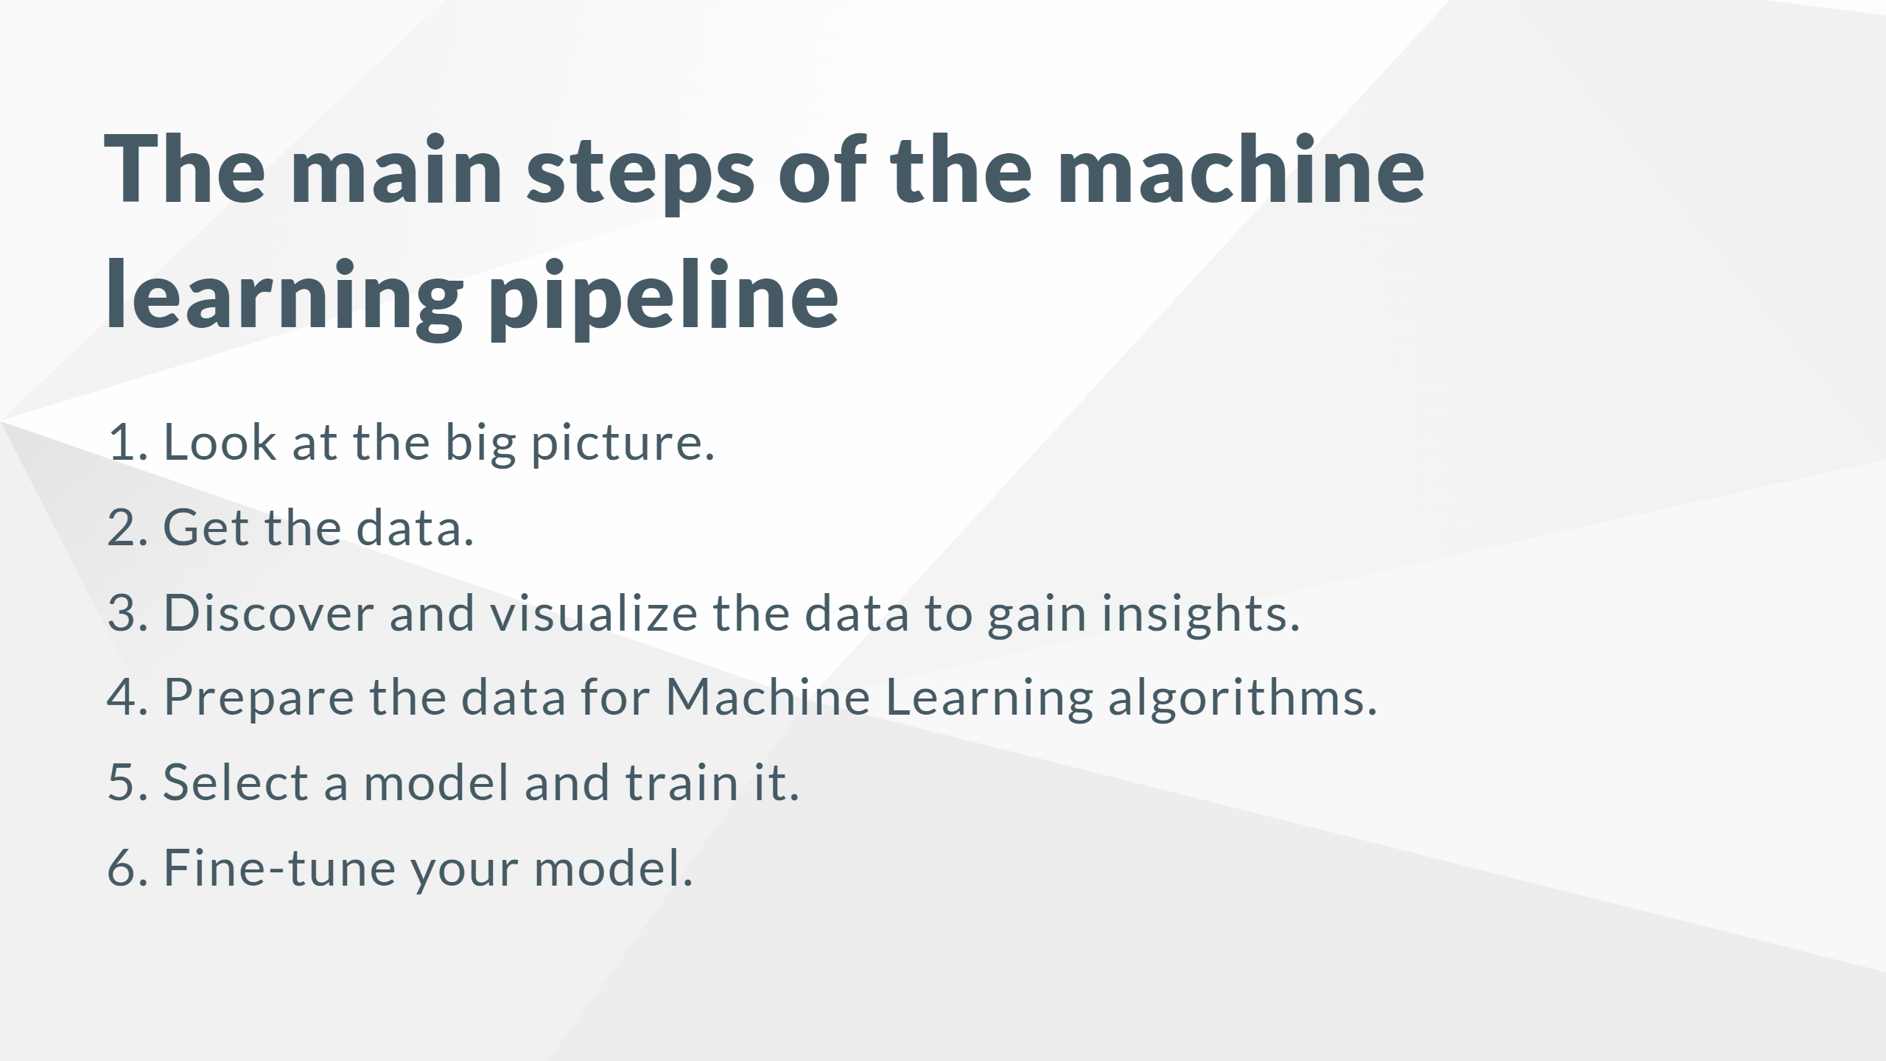

Slide 8
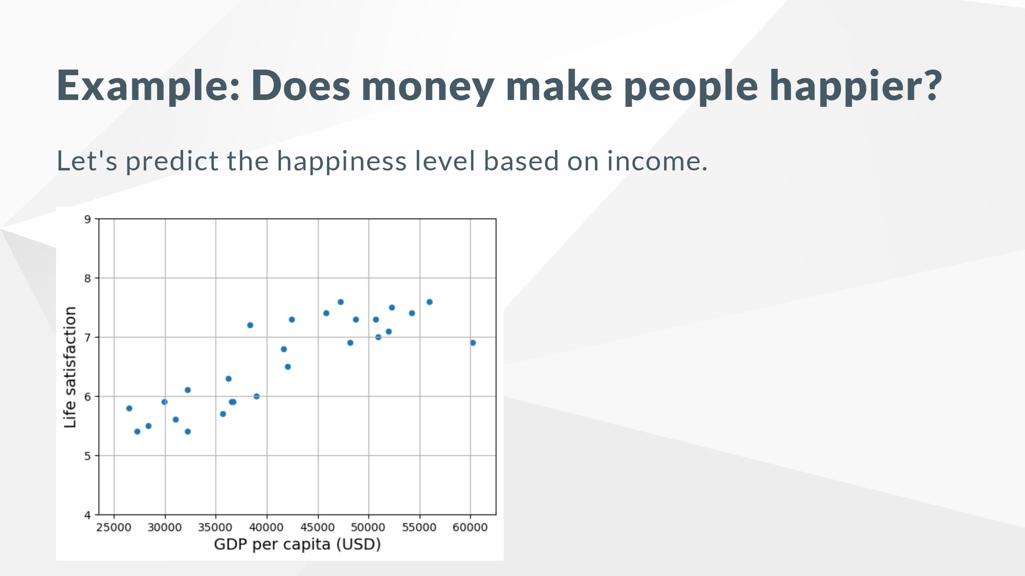

Slide 9
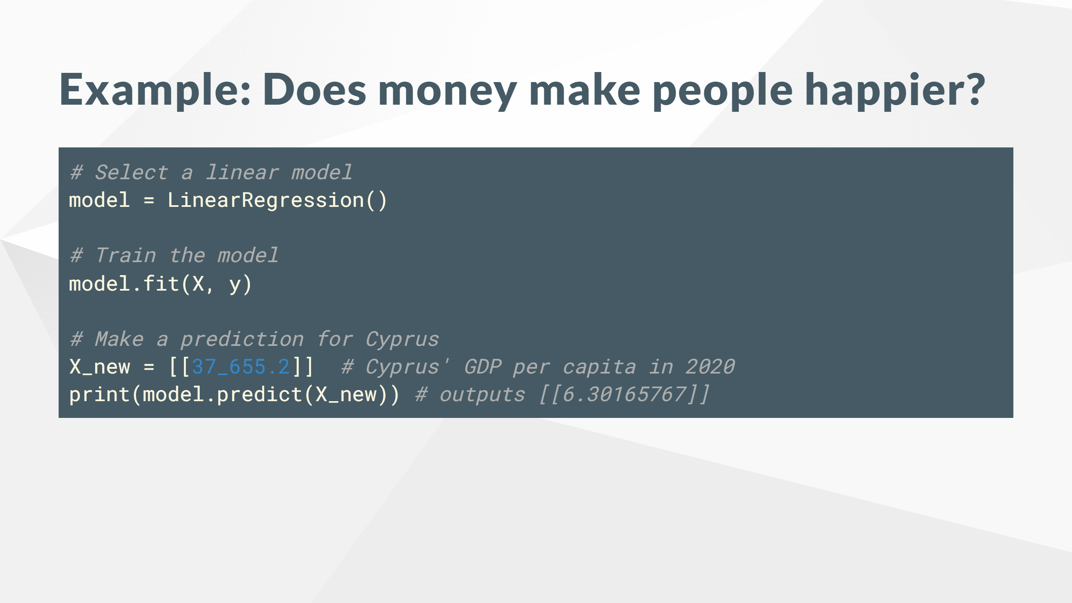

Slide 10
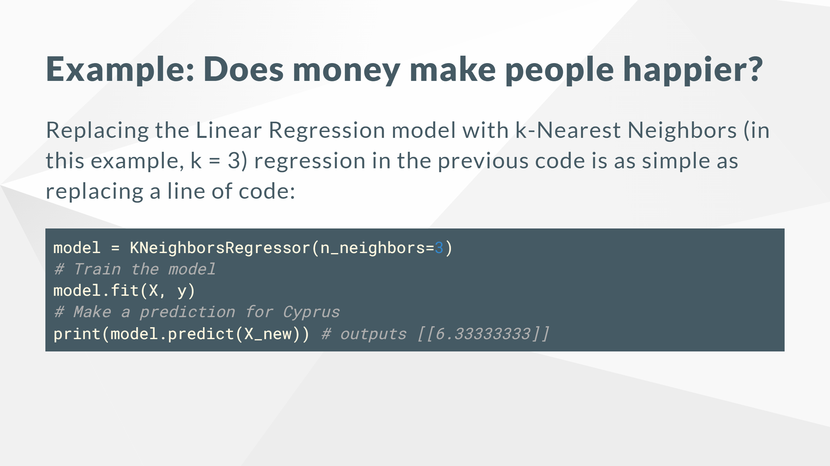

Slide 11
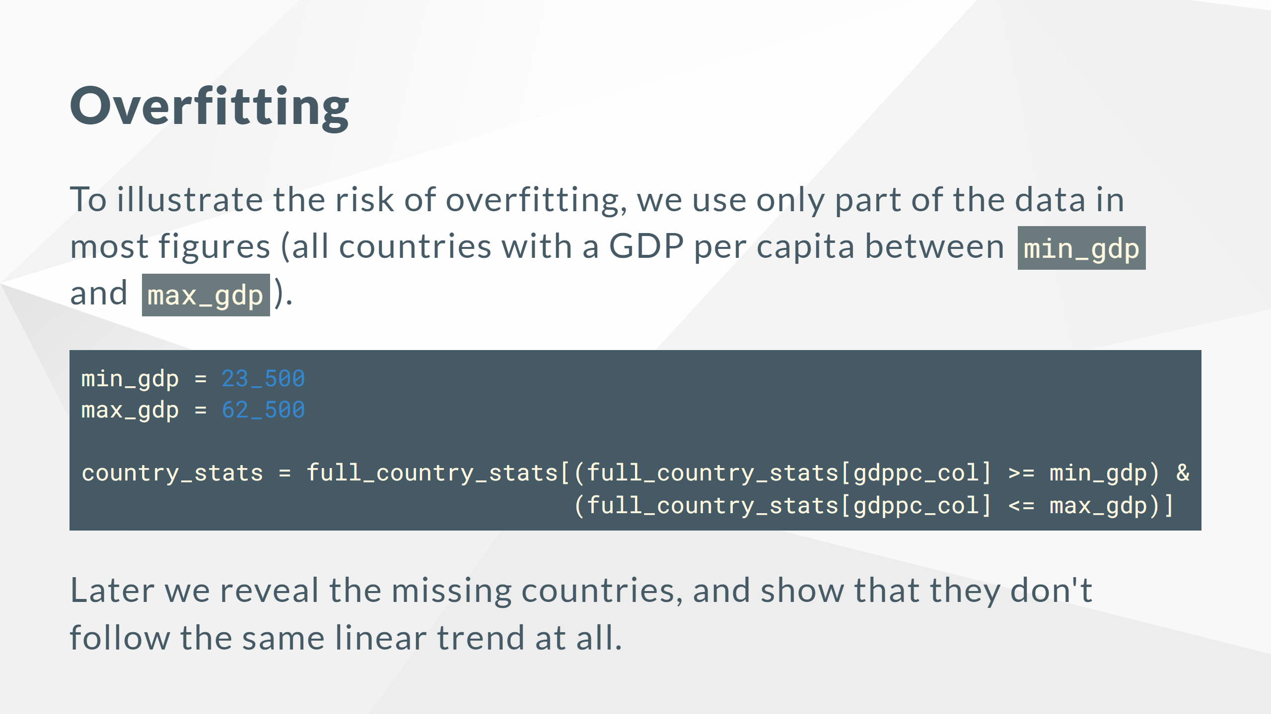

Slide 12
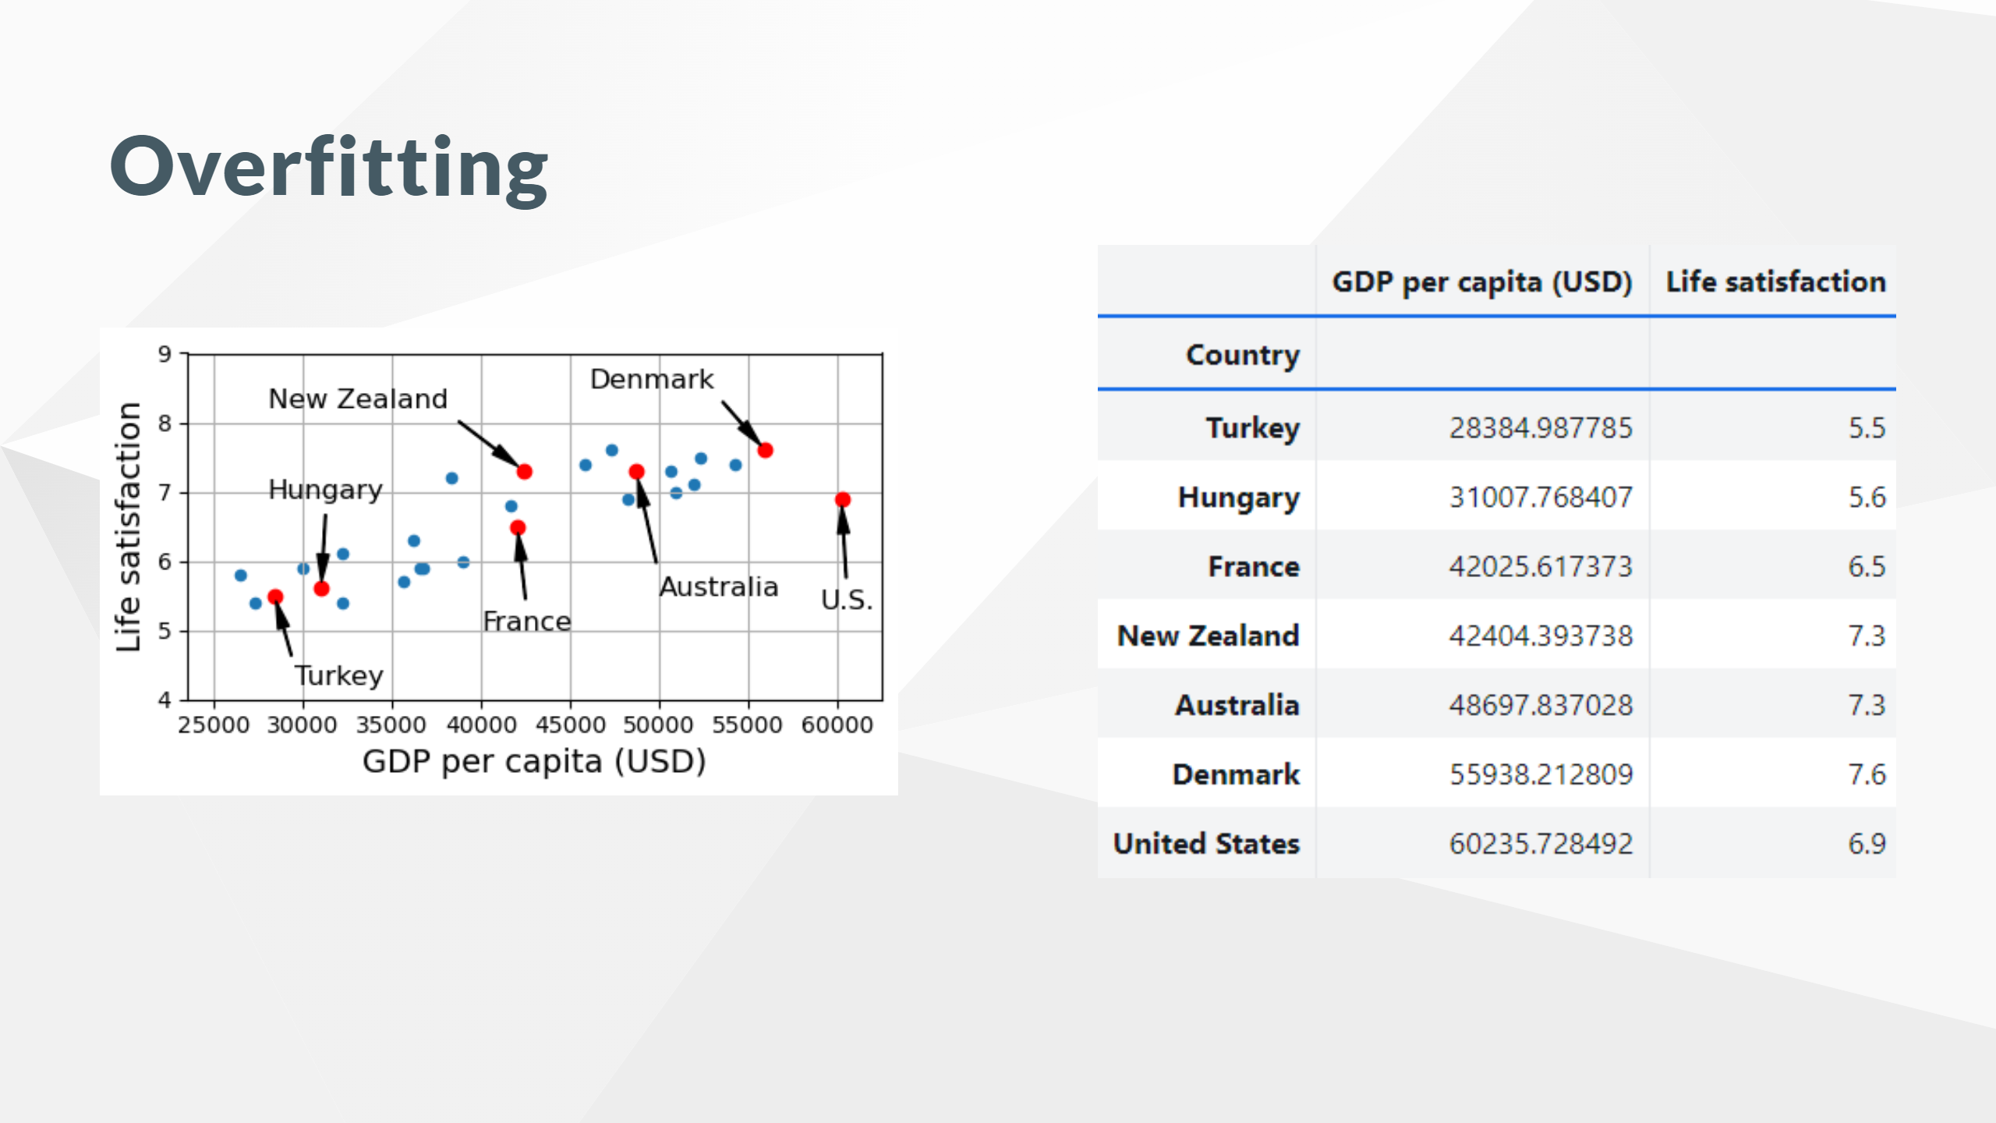

Slide 13
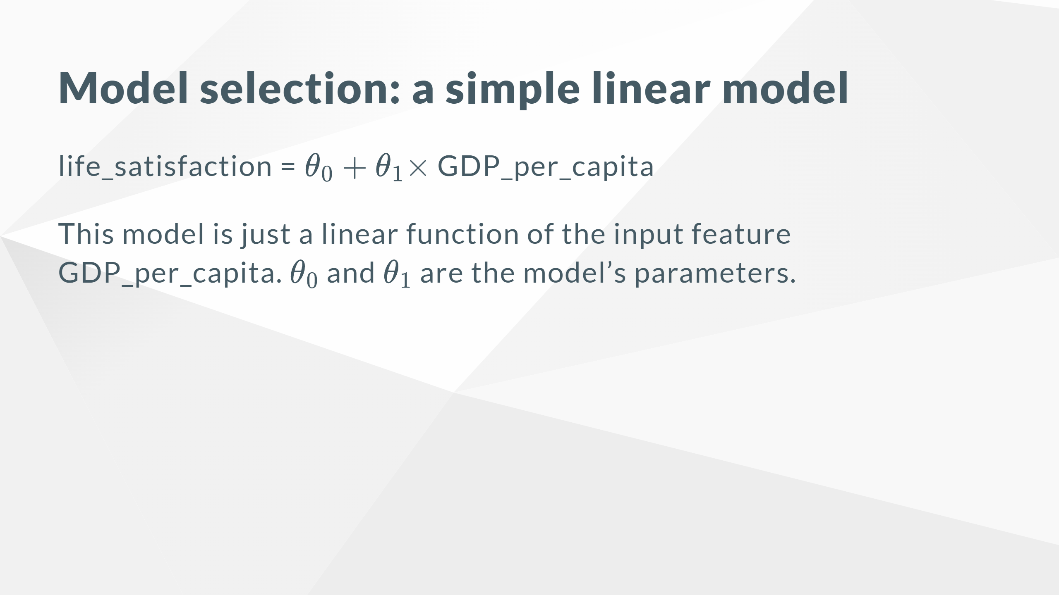

Slide 14
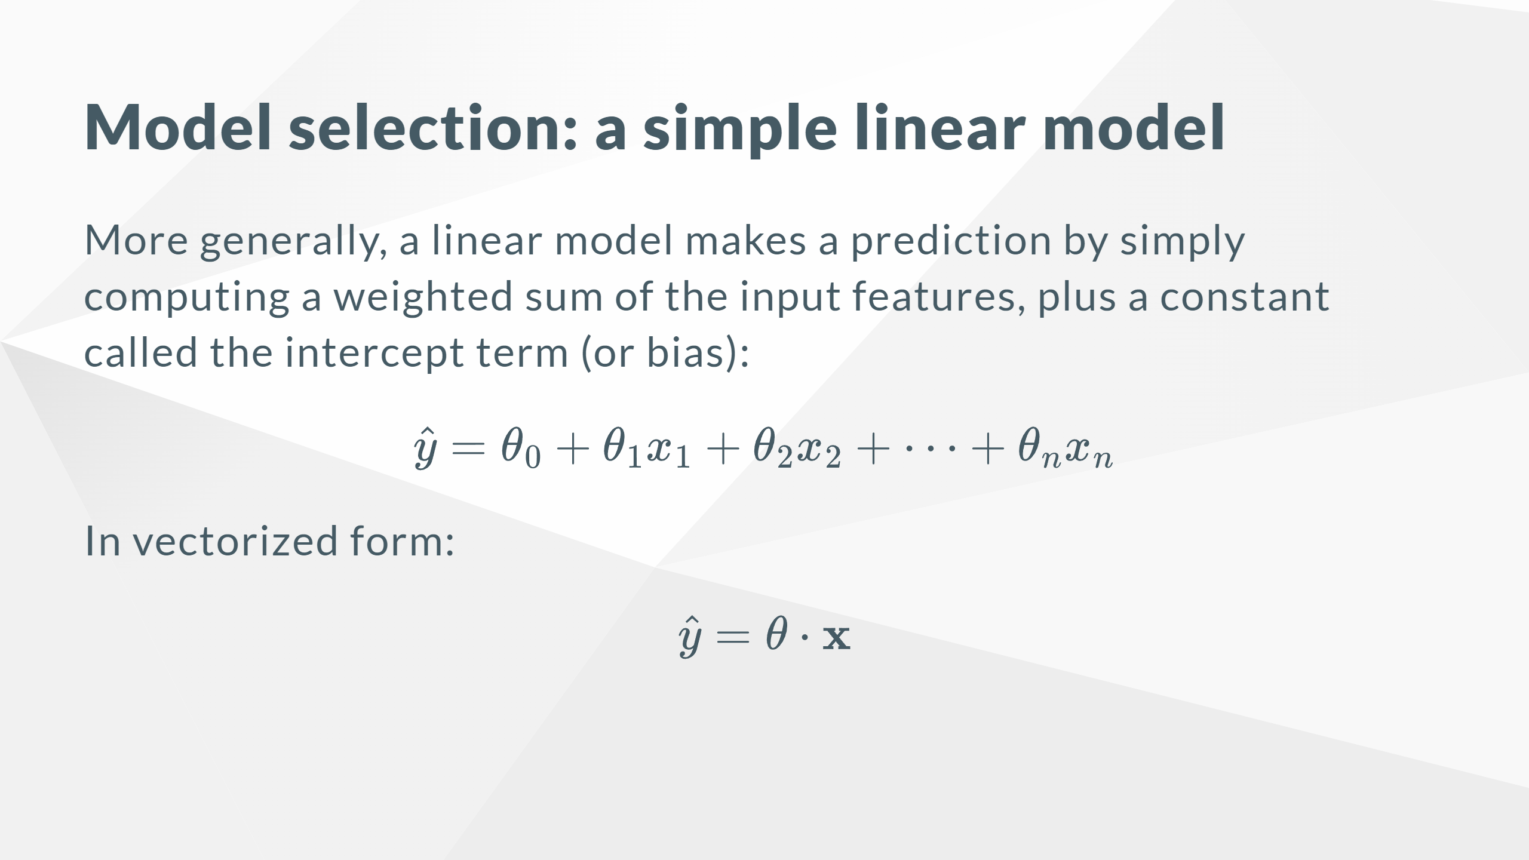

Slide 15
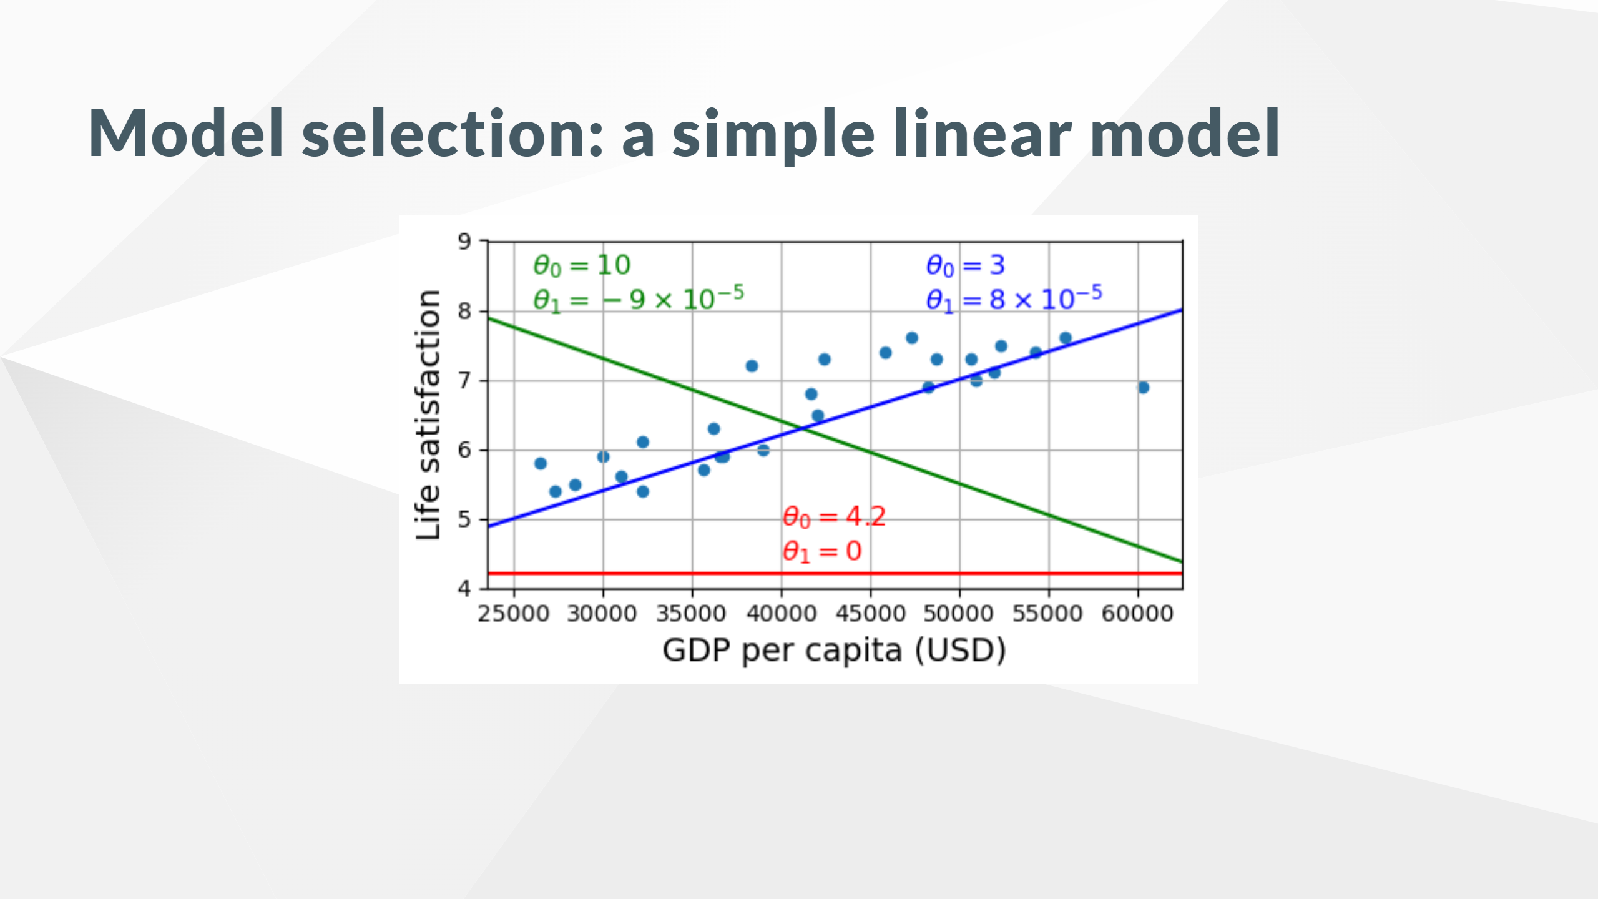

Slide 16
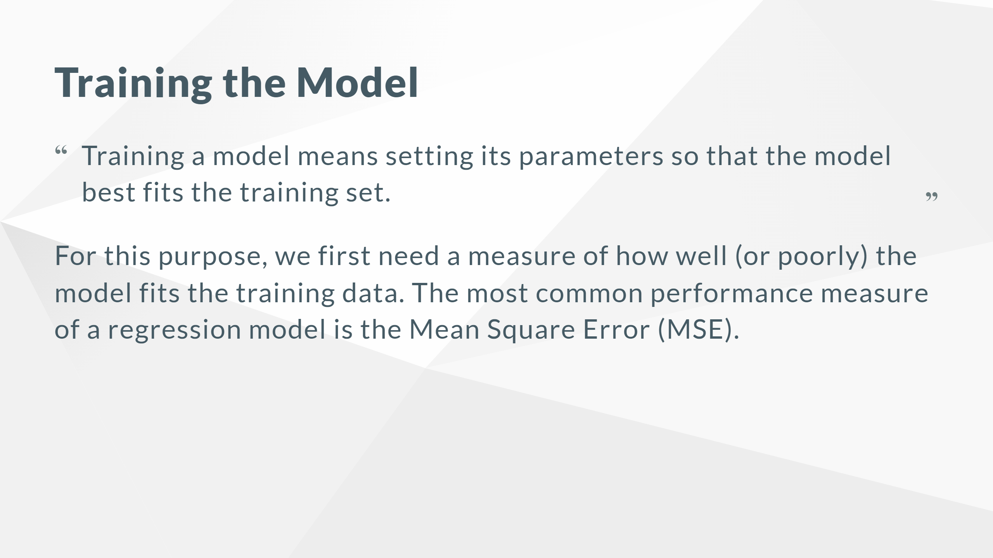

Slide 17
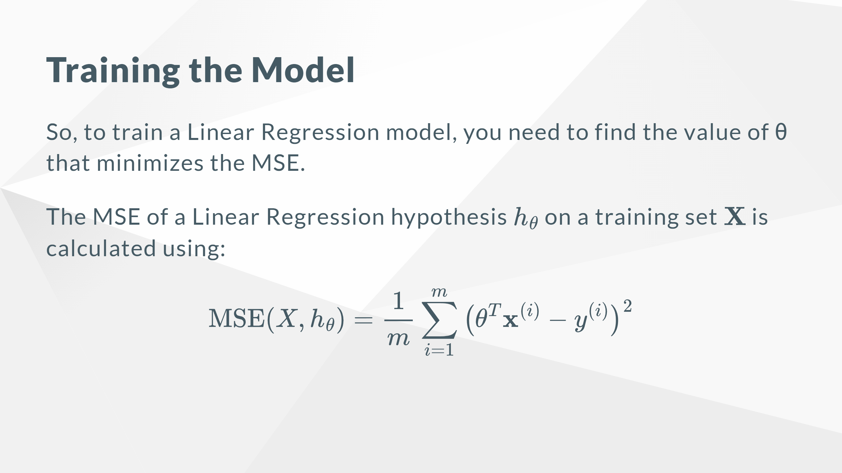

Slide 18
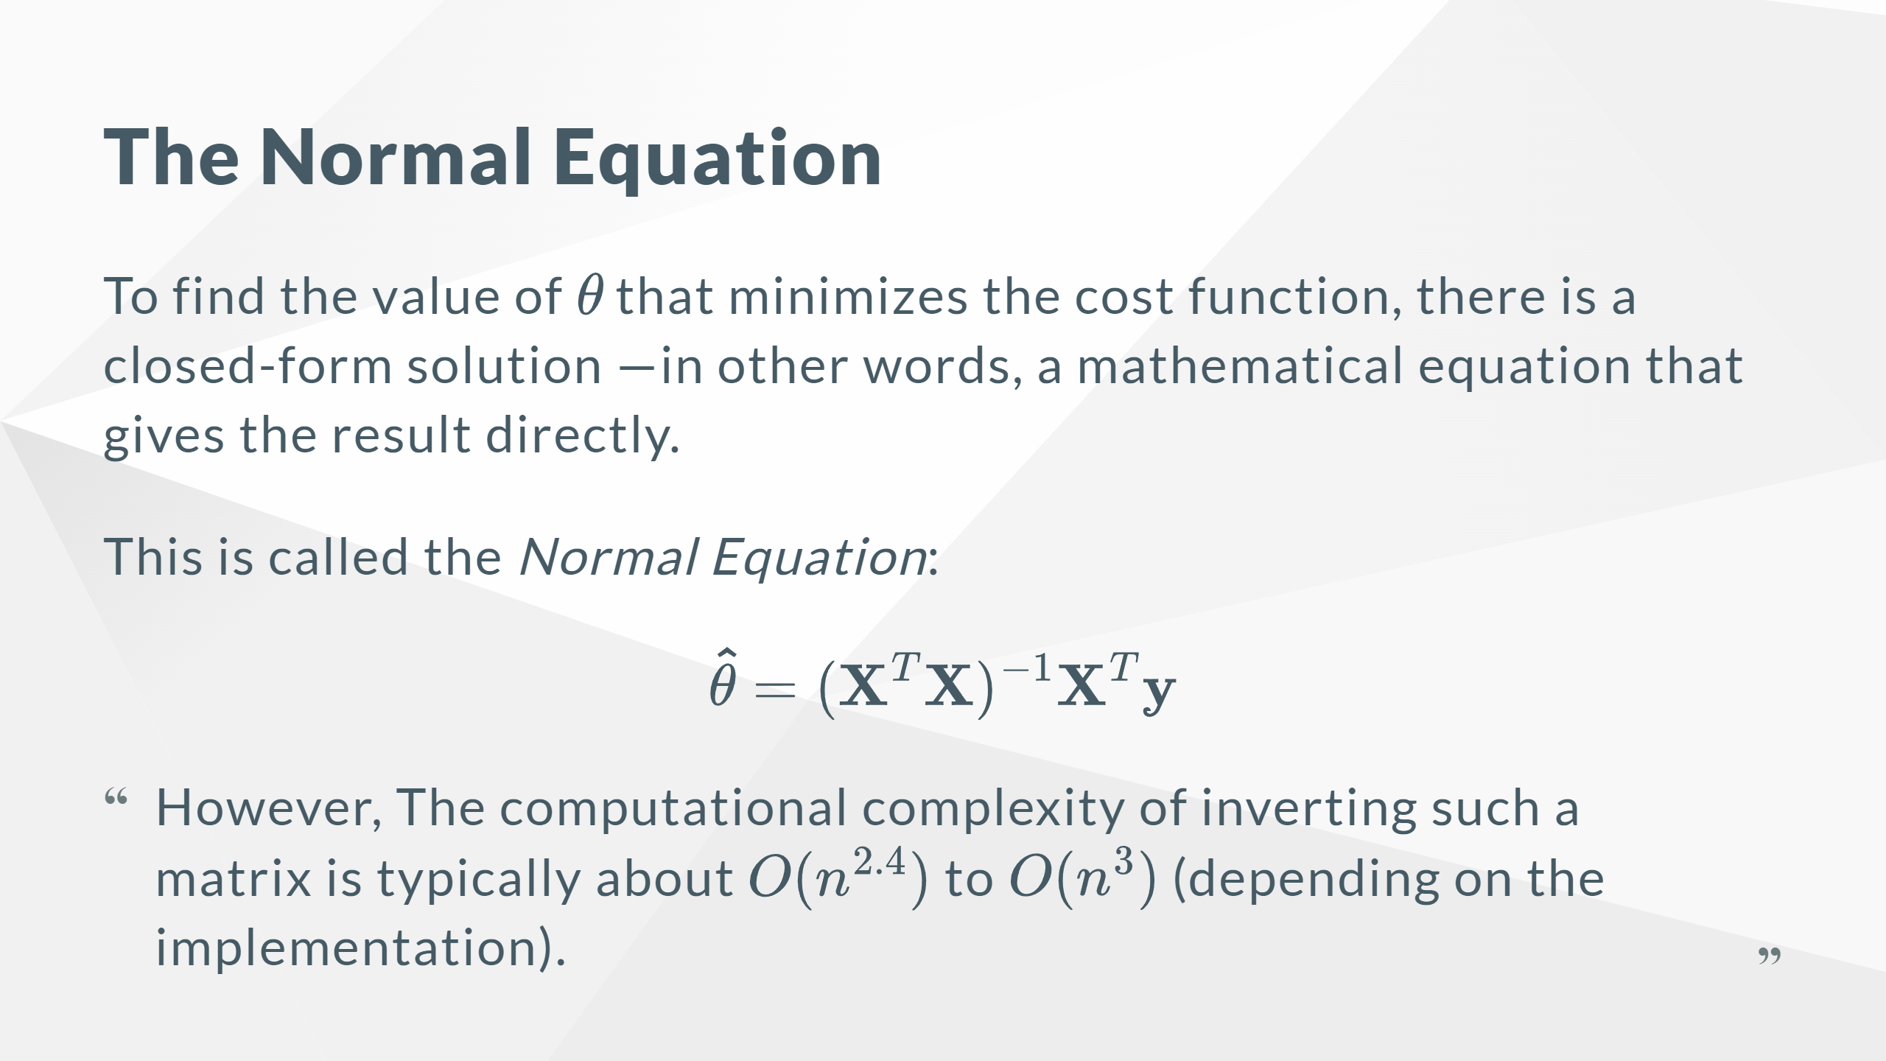
Notes:
In other words, if you double the number of features, you multiply the computation time by roughly $2^{2.4} = 5.3$ to $2^3 = 8$. Instead, the approach used by `Scikit-Learn`’s `LinearRegression` class is about $O(n^2)$.

Slide 19
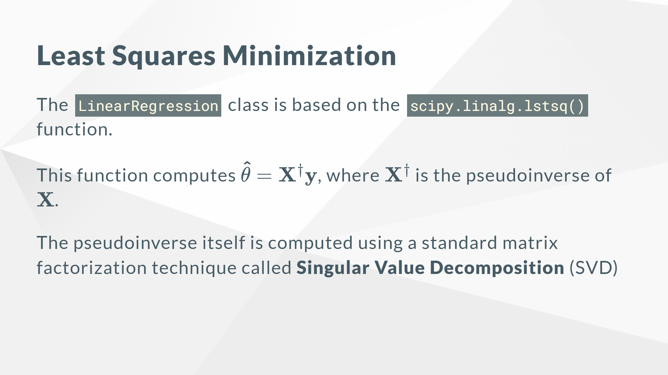
Notes:
This approach is more efficient than computing the *Normal Equation*, plus it handles edge cases nicely. Indeed, the Normal Equation may not work if the matrix $\mathbf{X}^T\mathbf{X}$ is not invertible, but the pseudoinverse is always defined.

Slide 20
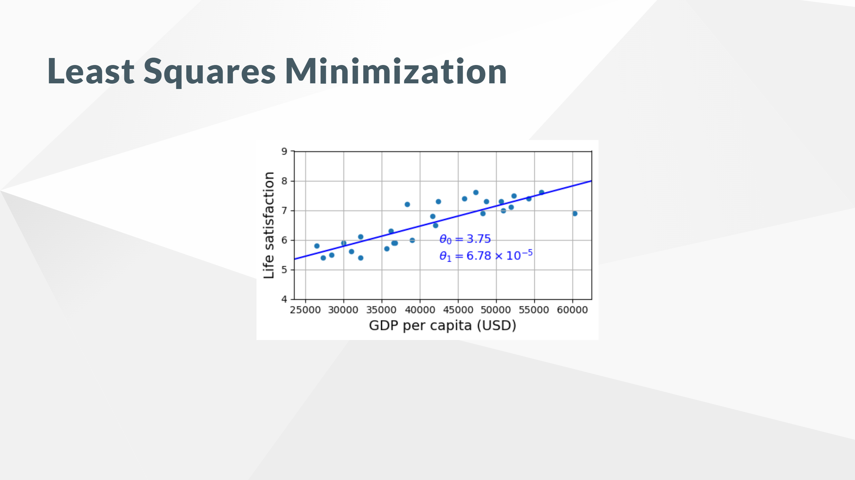

Slide 21
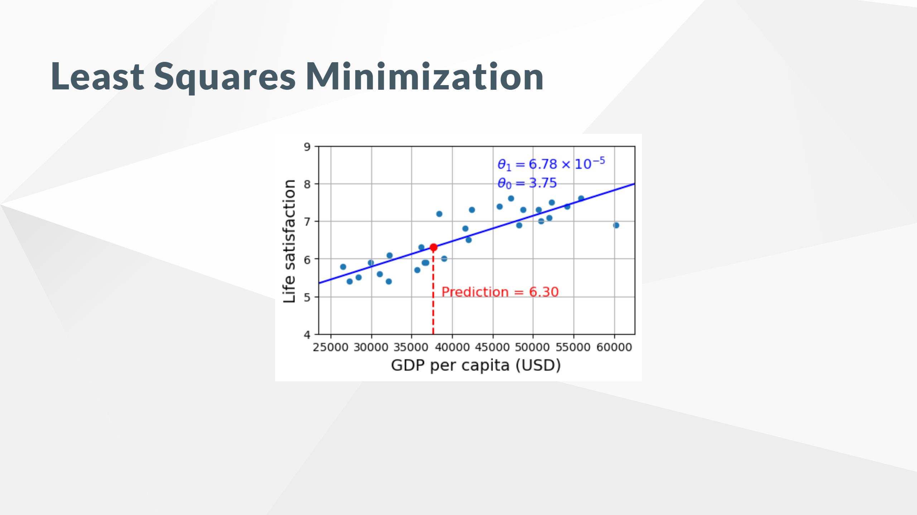

Slide 22
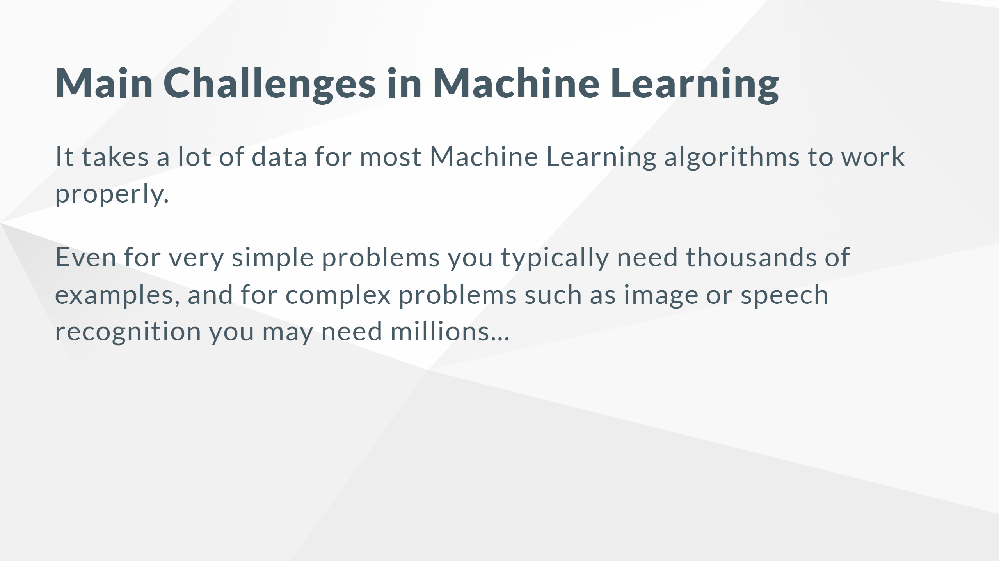

Slide 23
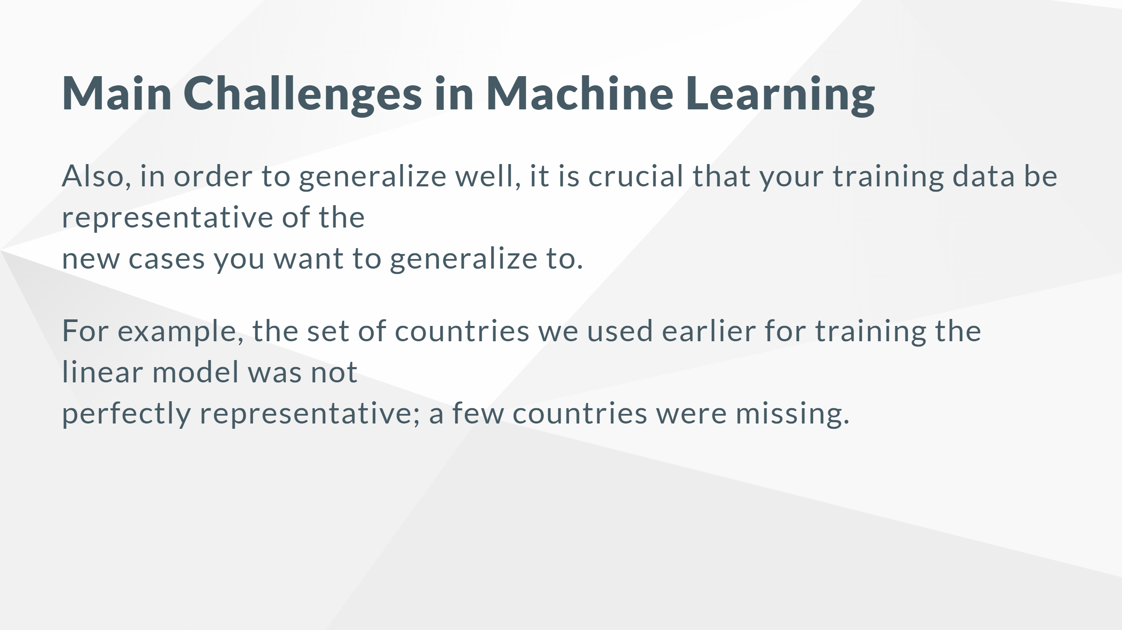

Slide 24
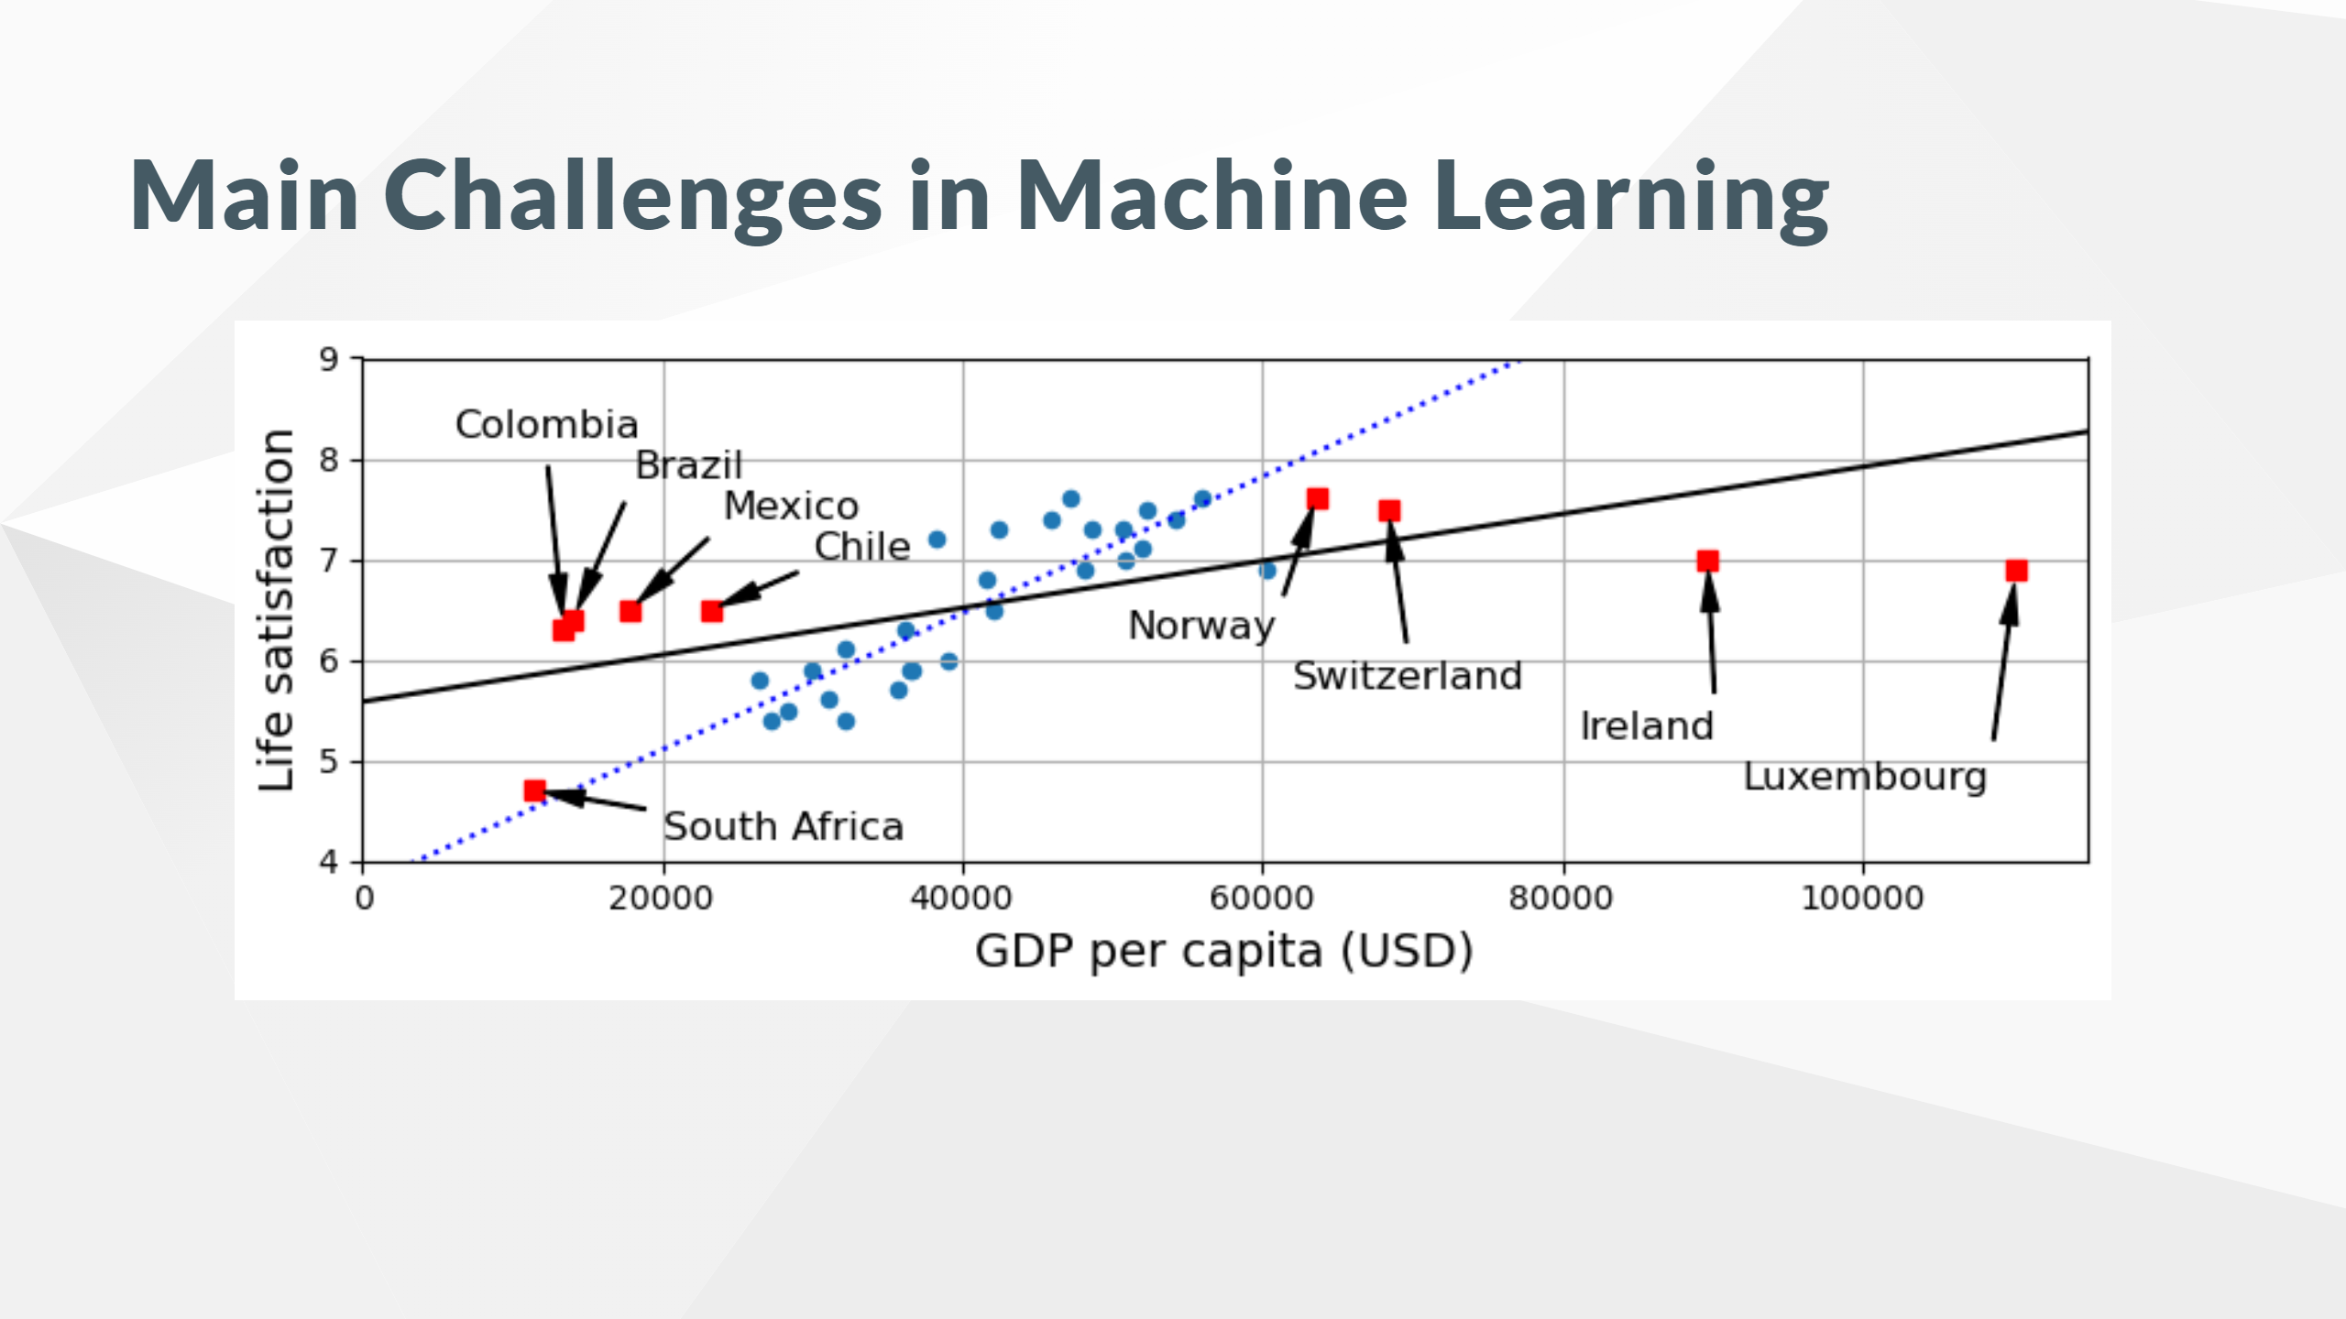

Slide 25
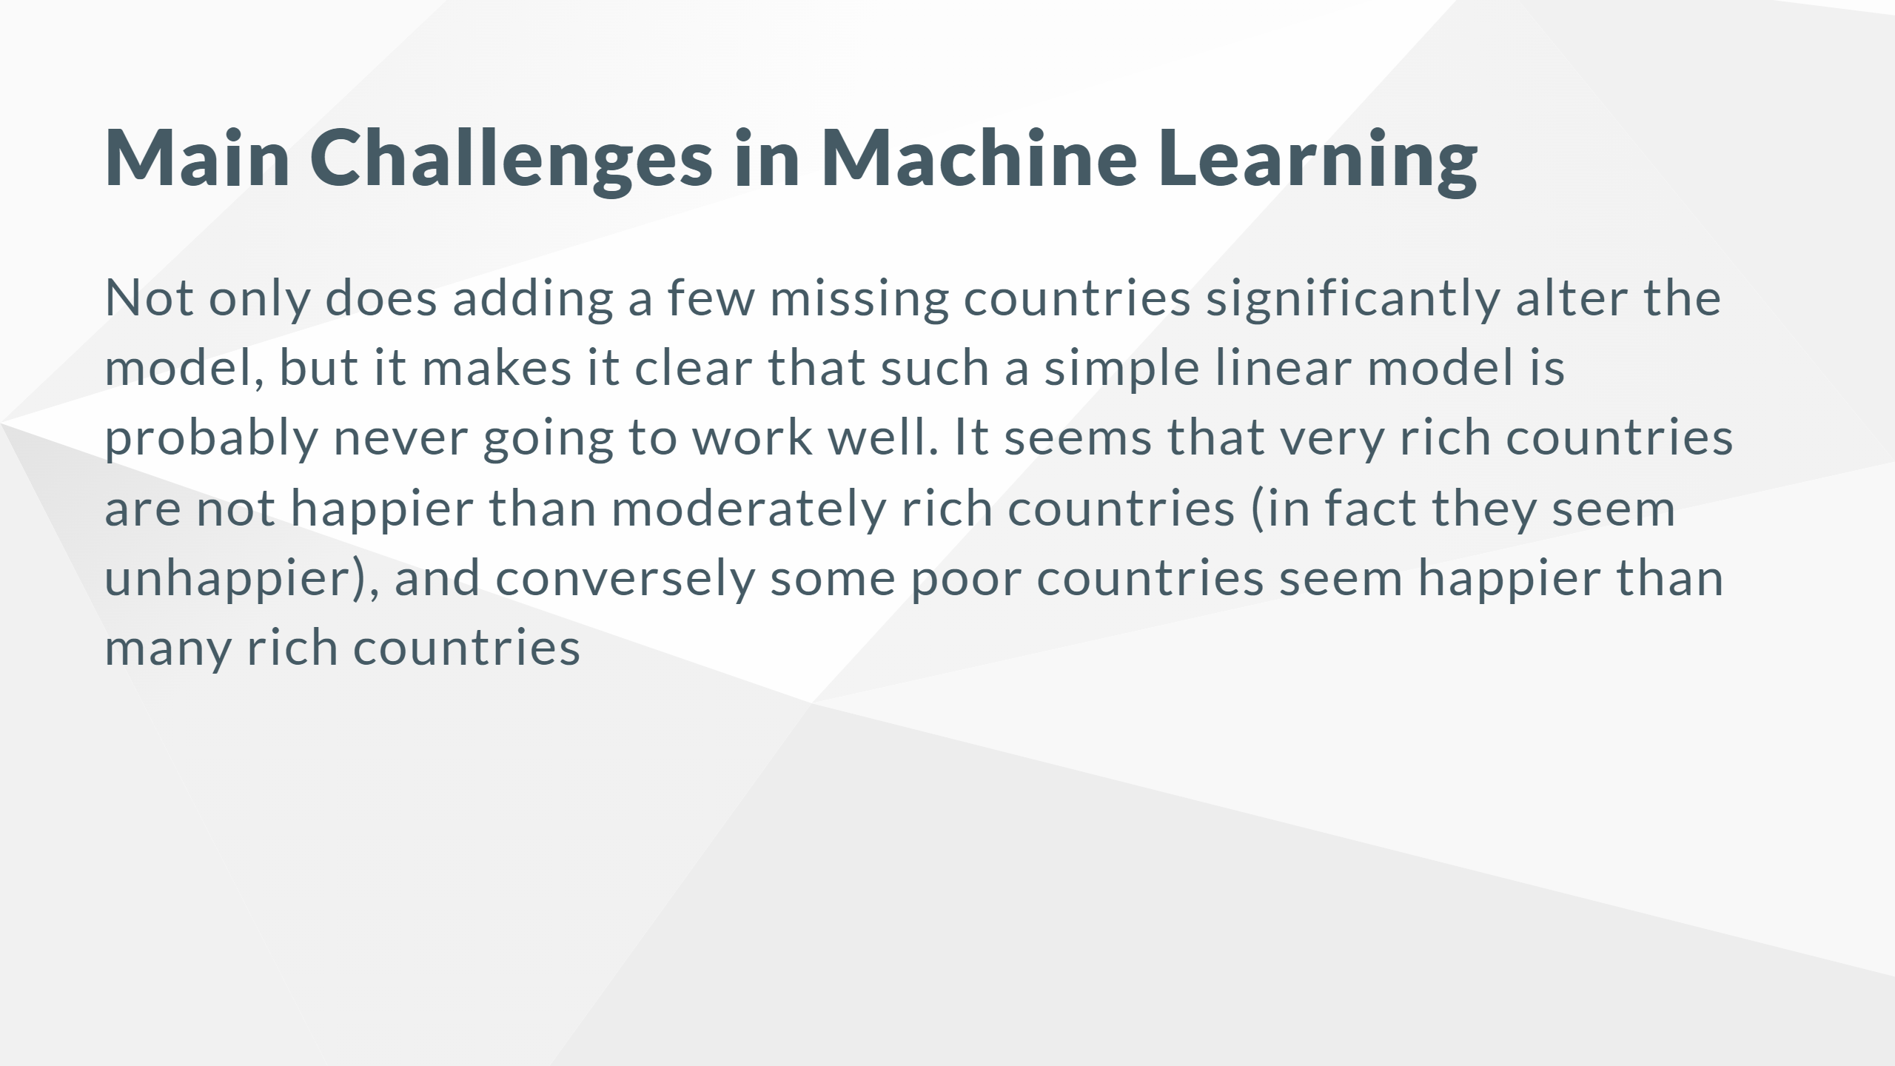

Slide 26
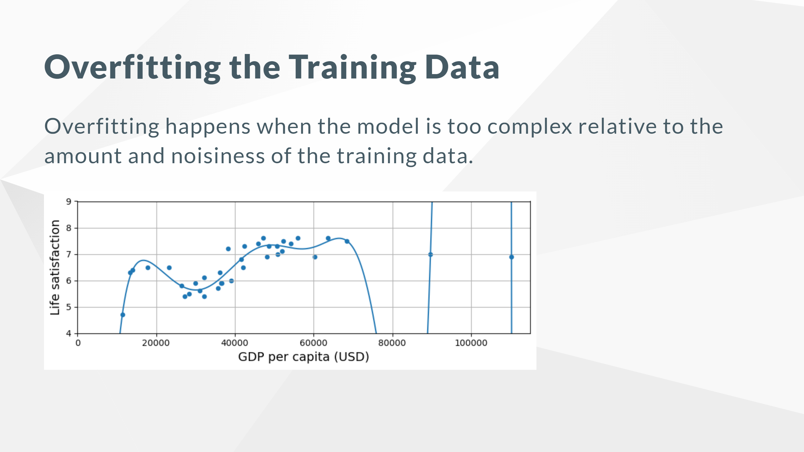

Slide 27
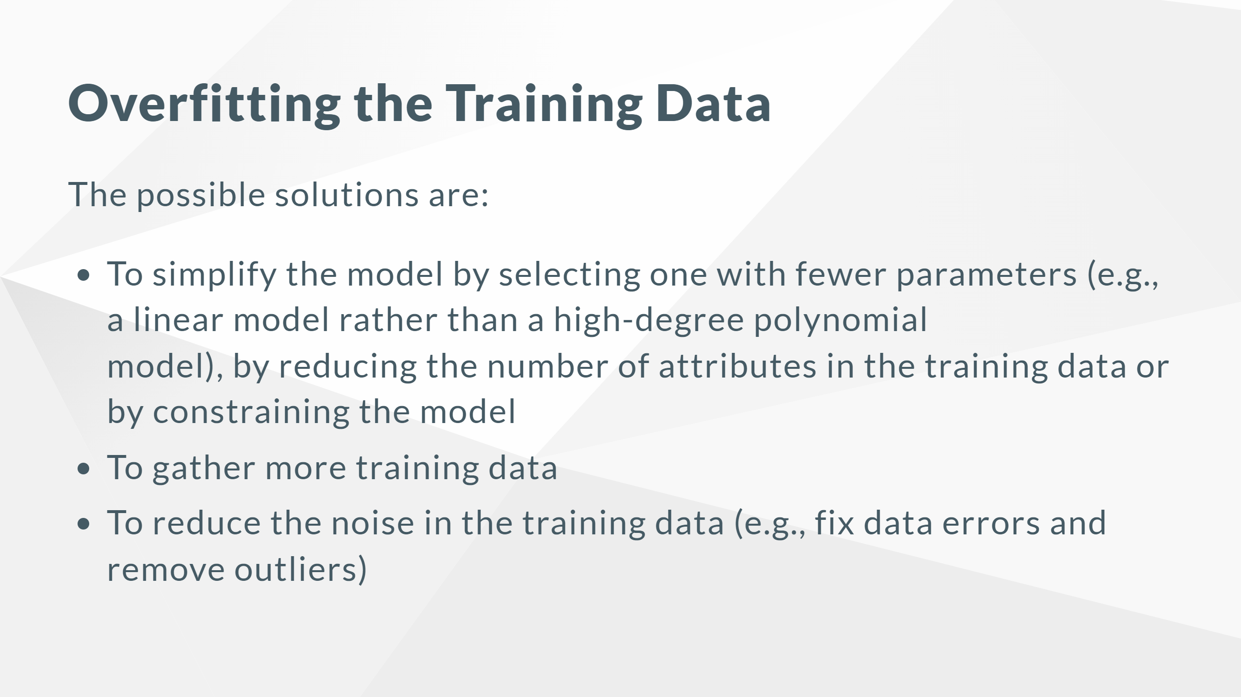

Slide 28
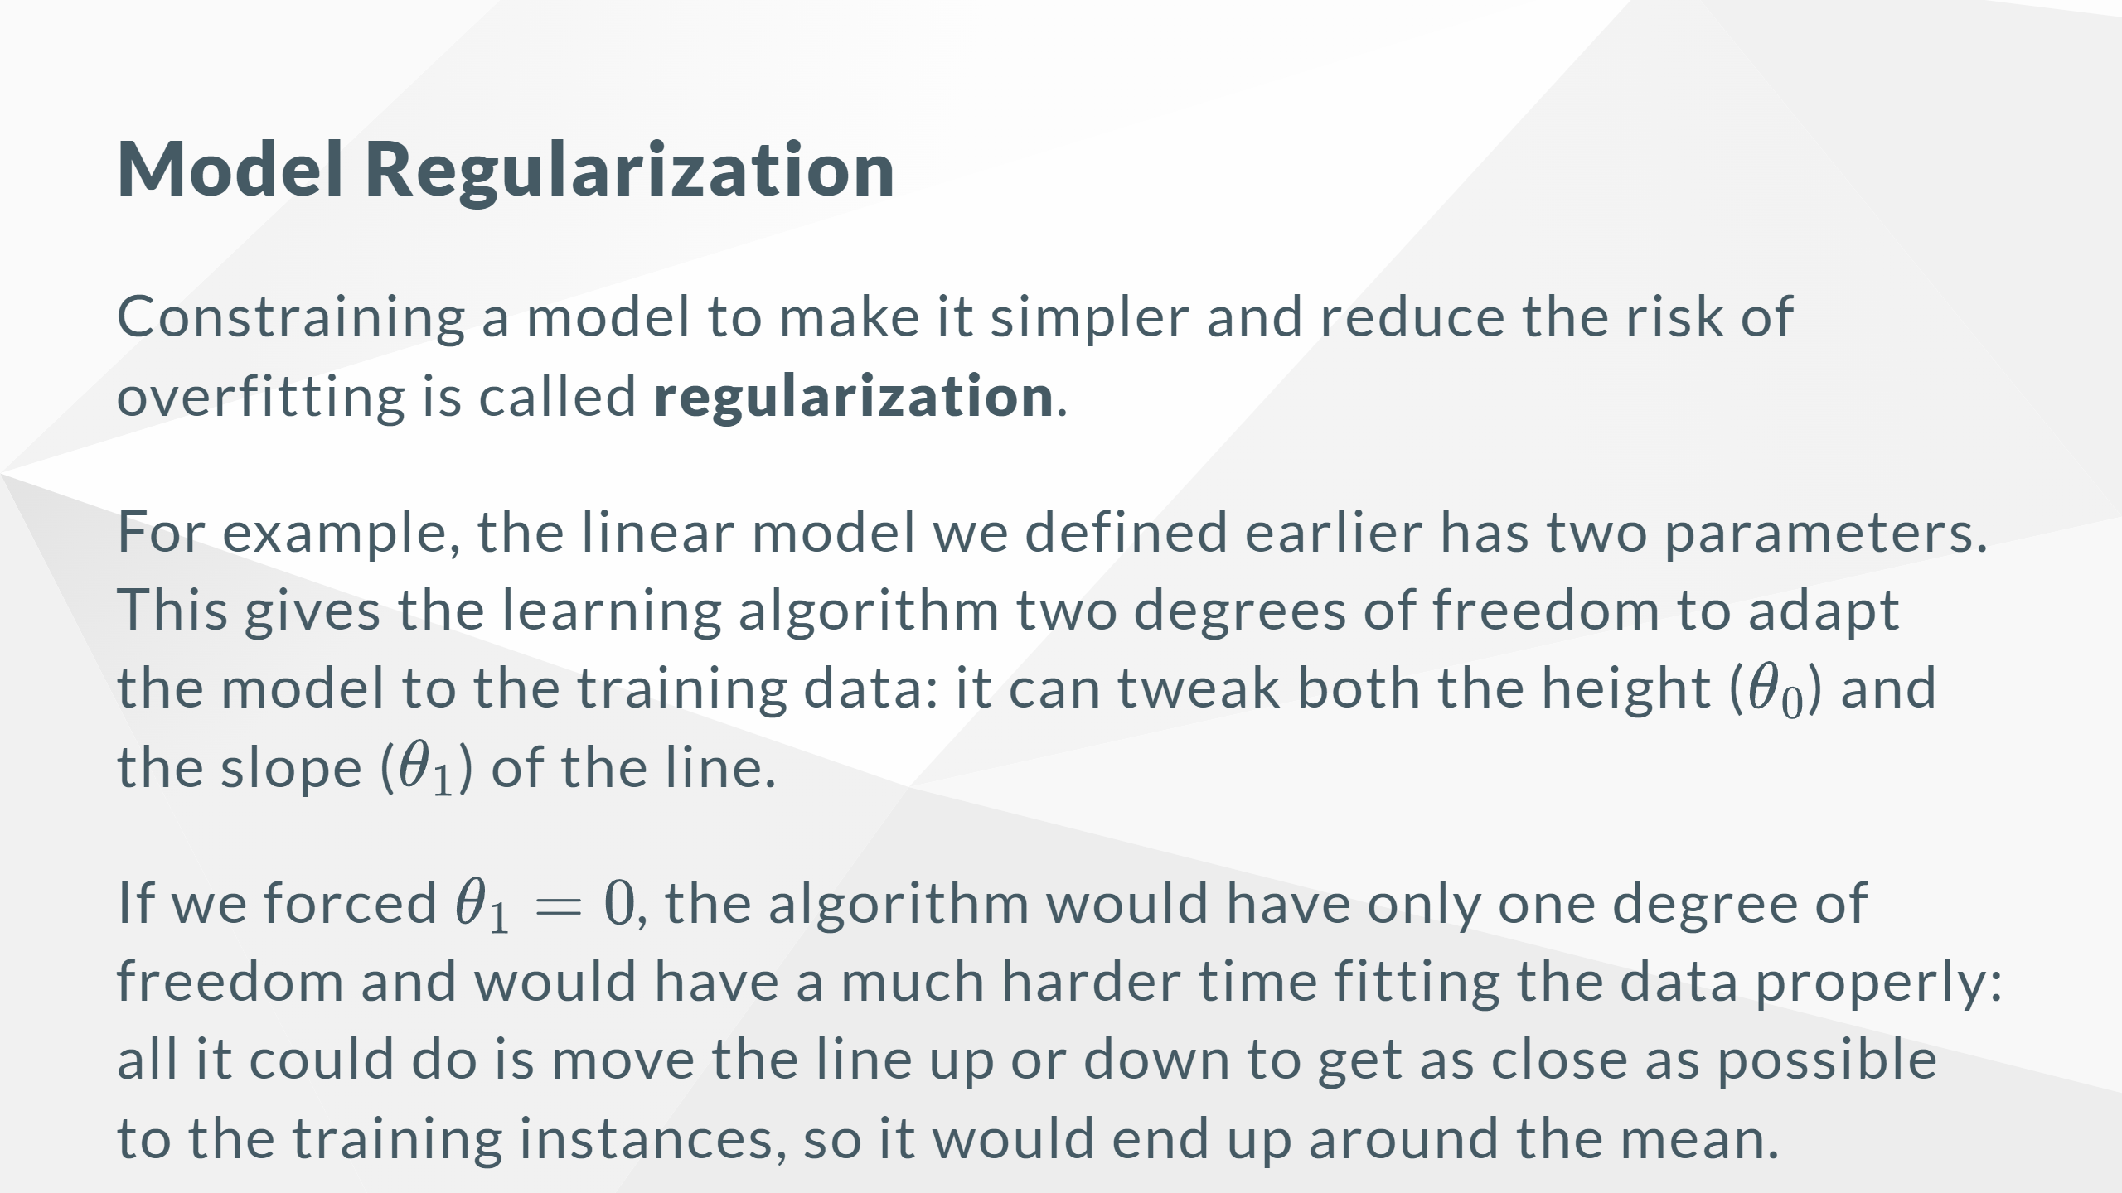

Slide 29
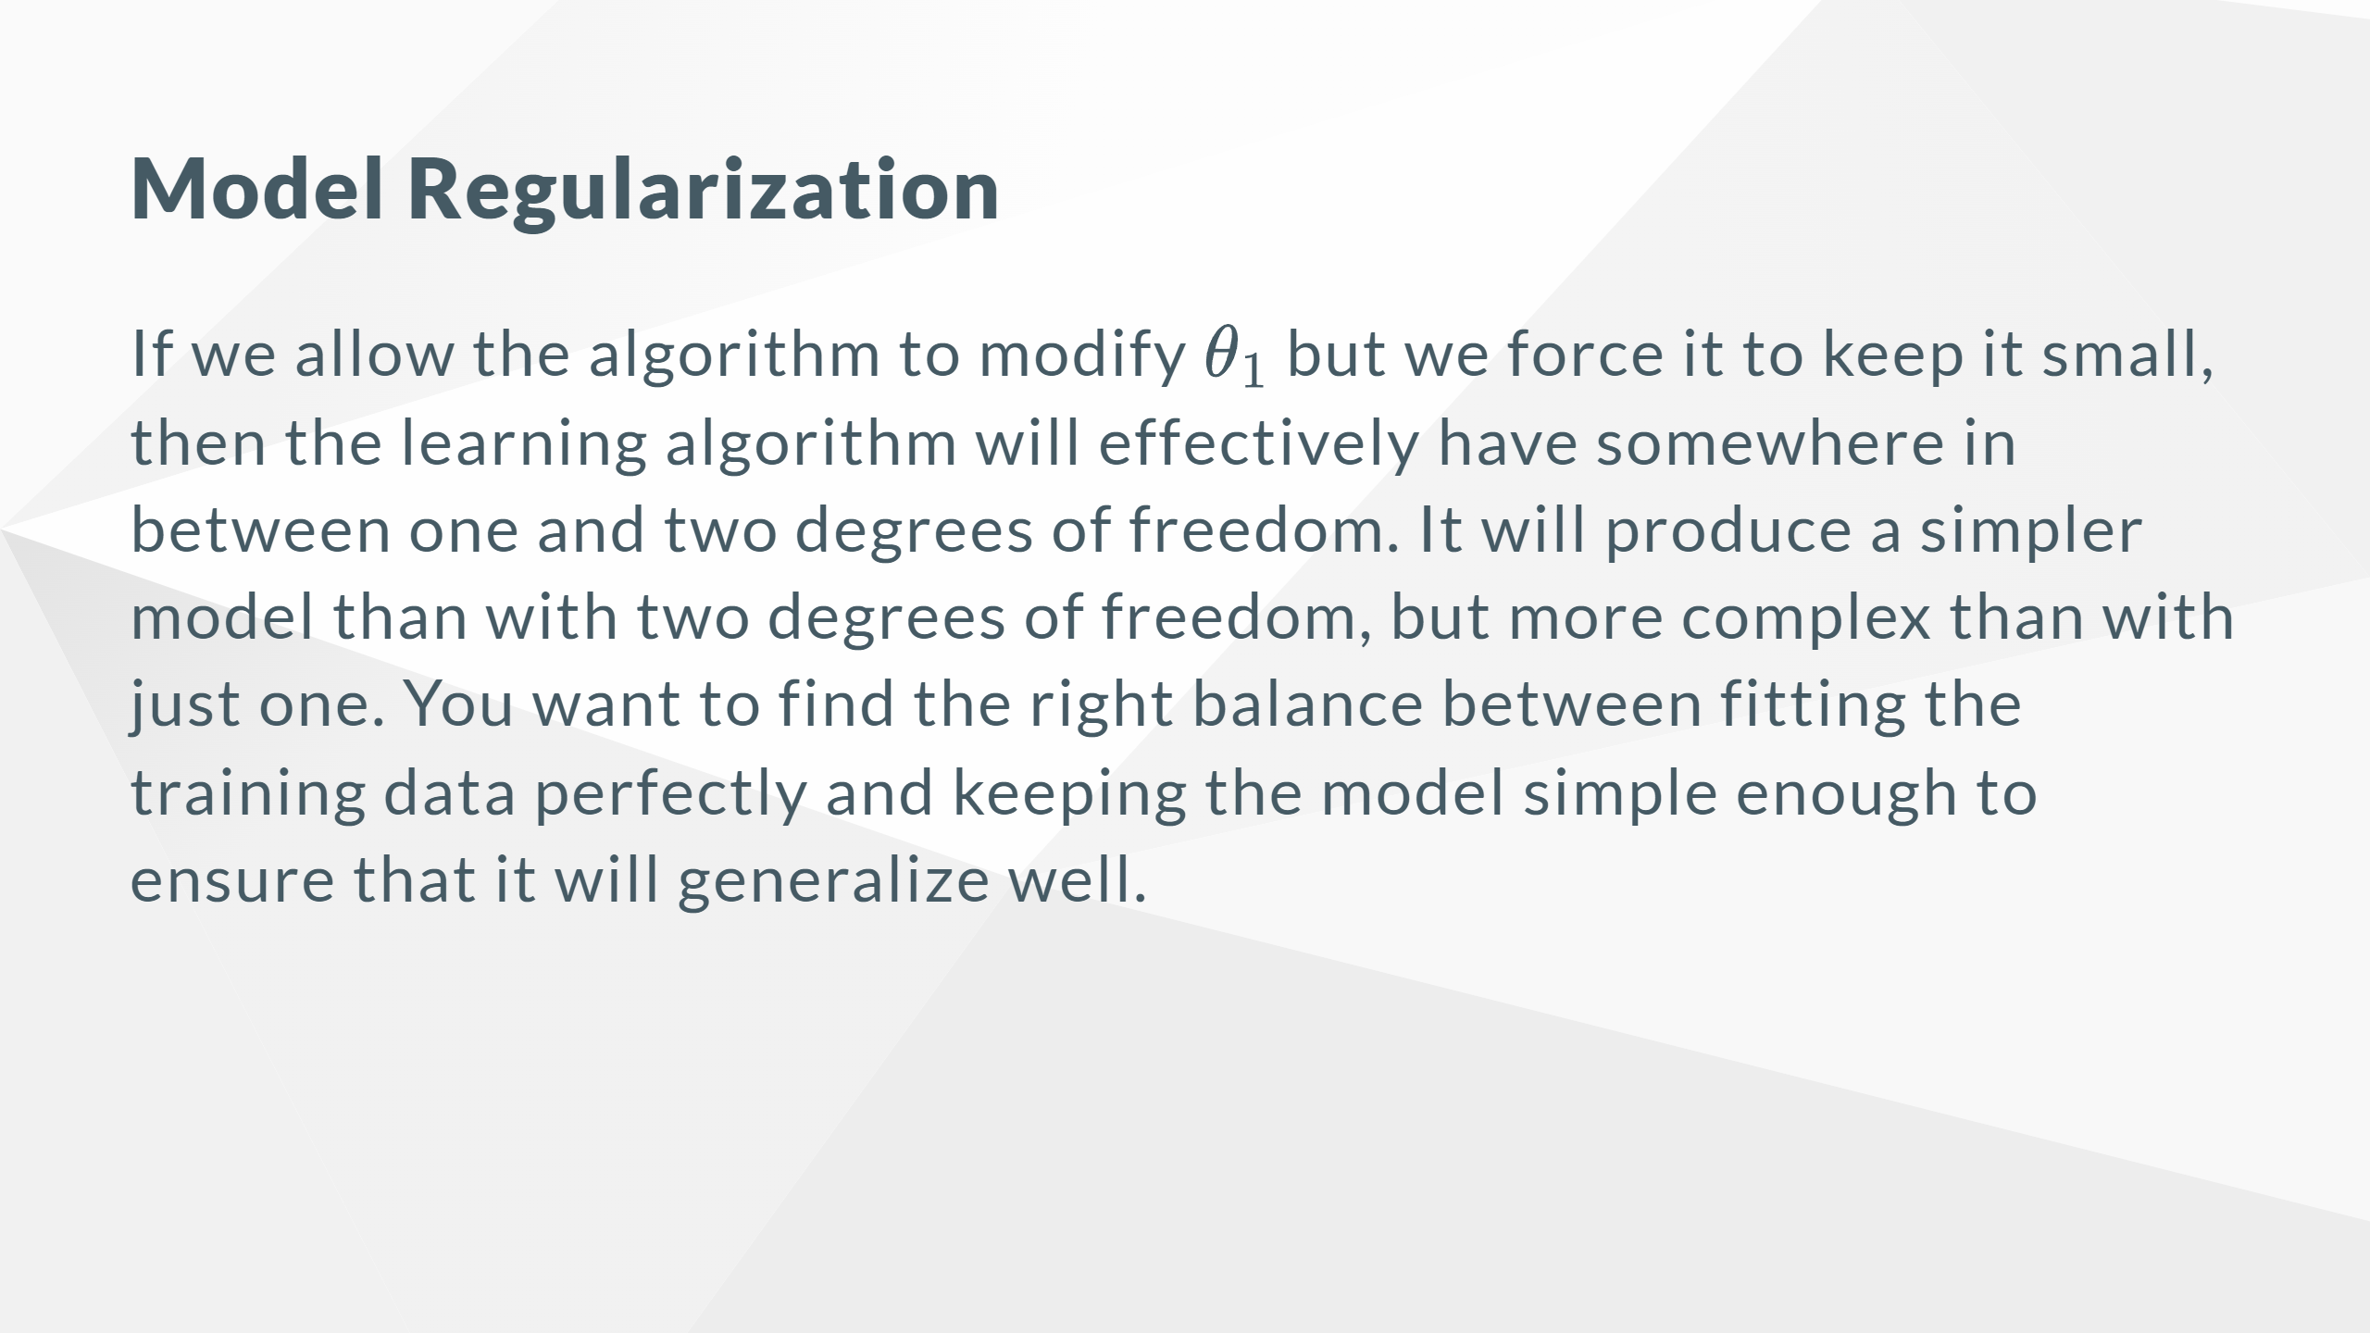

Slide 30
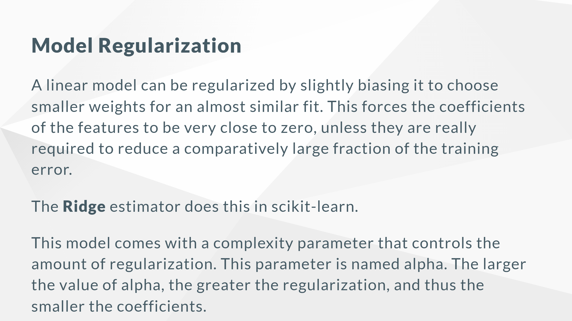

Slide 31
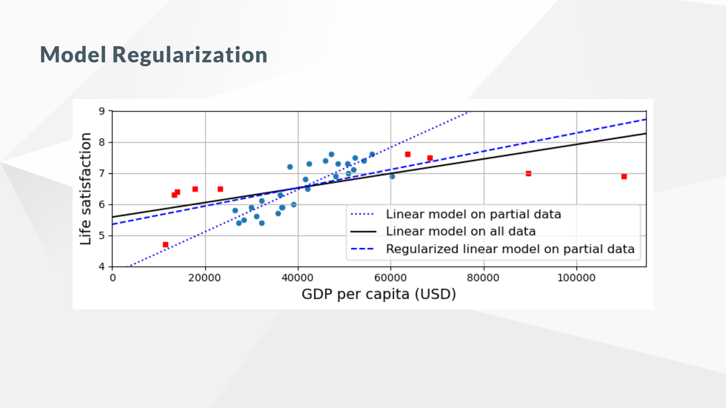

Slide 32
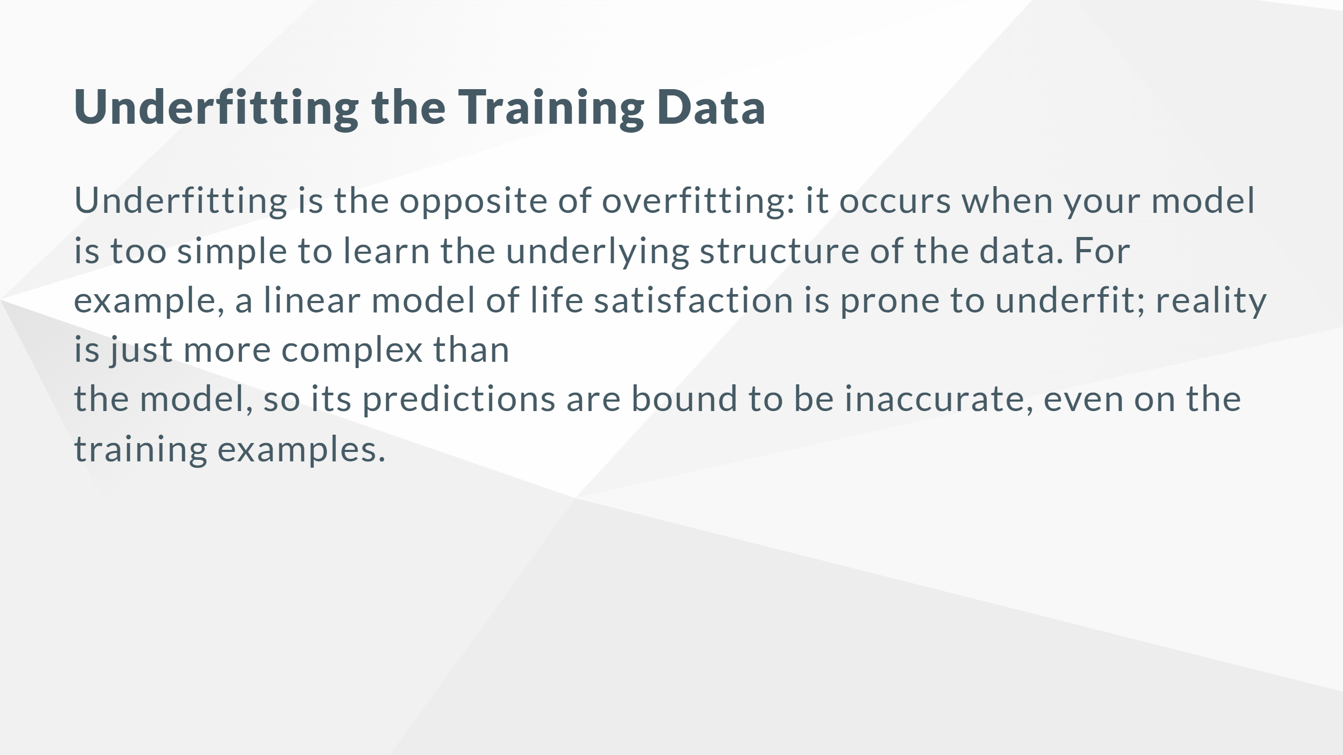

Slide 33
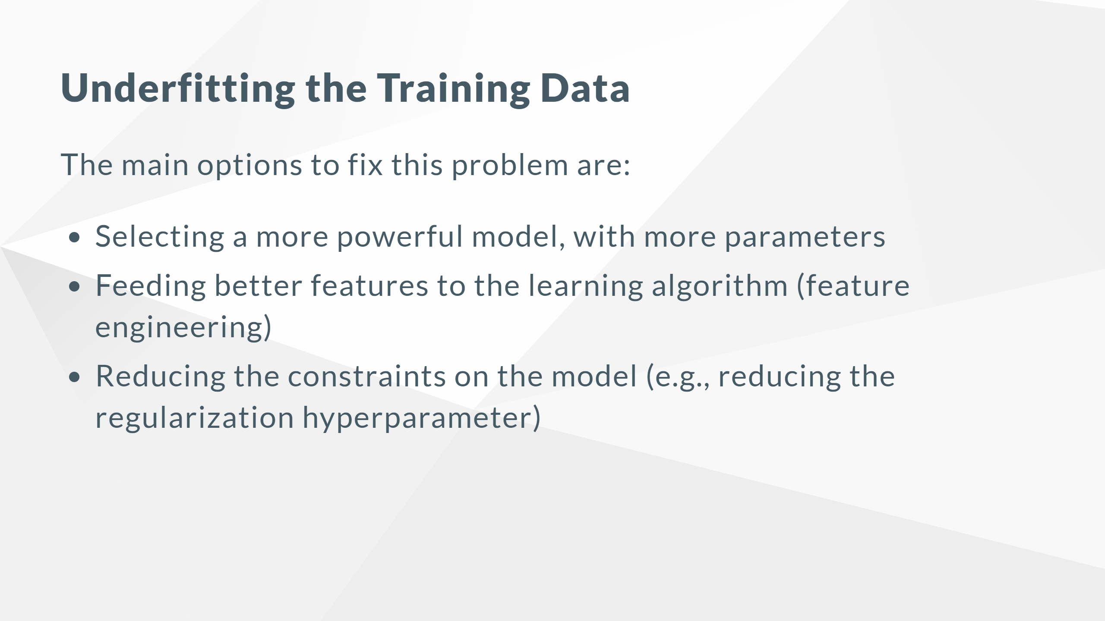

Slide 34
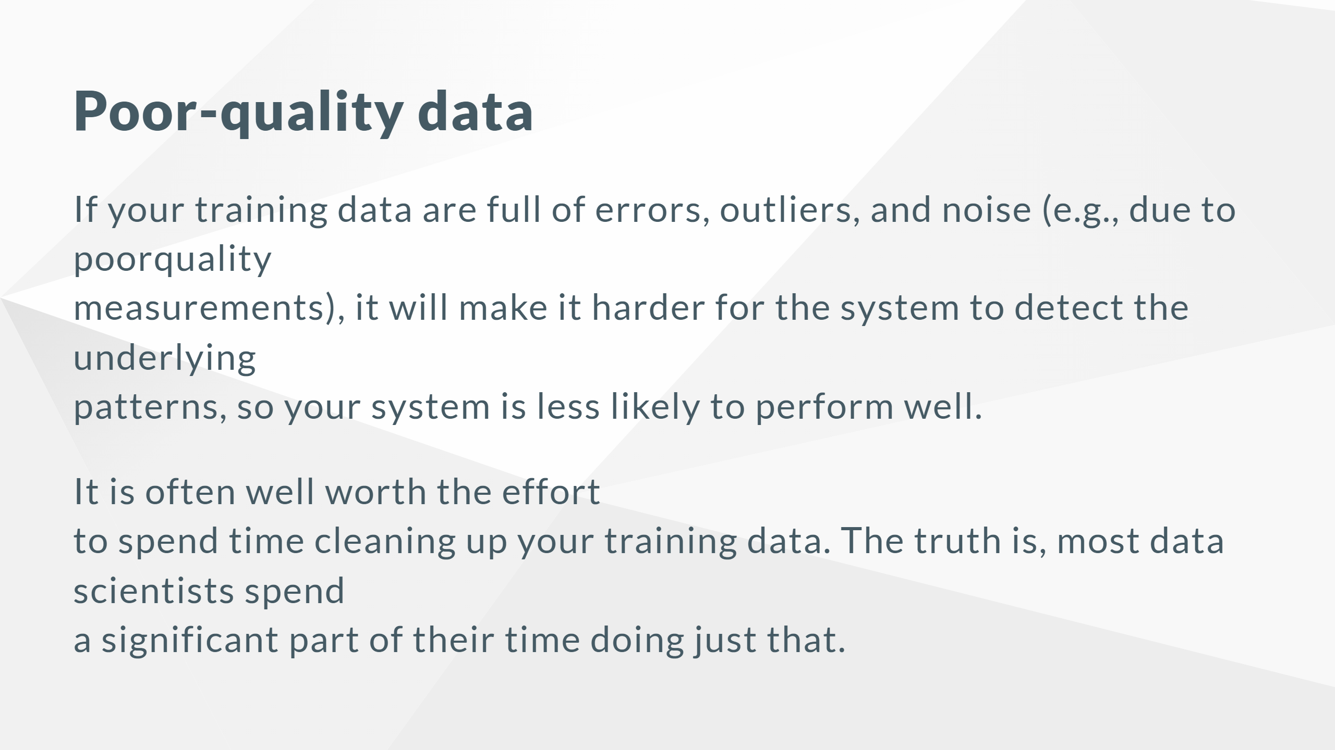

Slide 35
